Slide 1
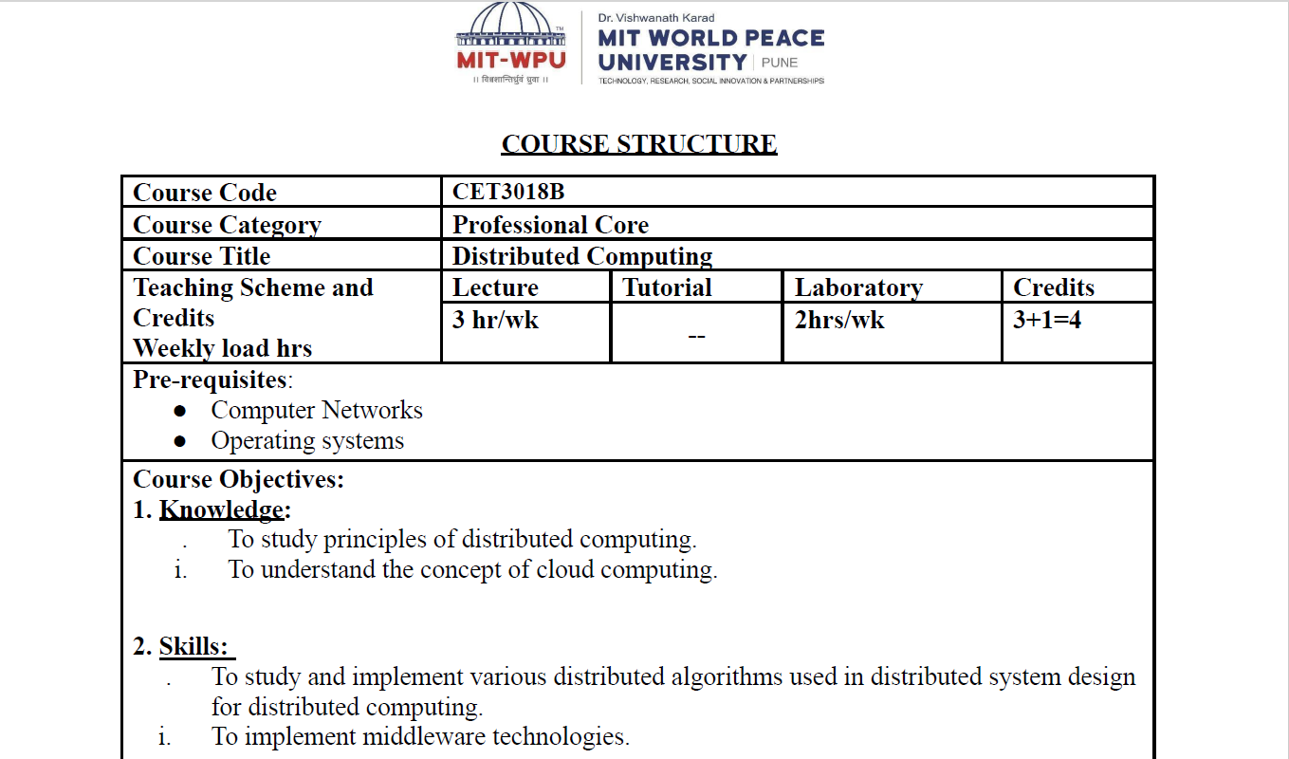

Slide 2
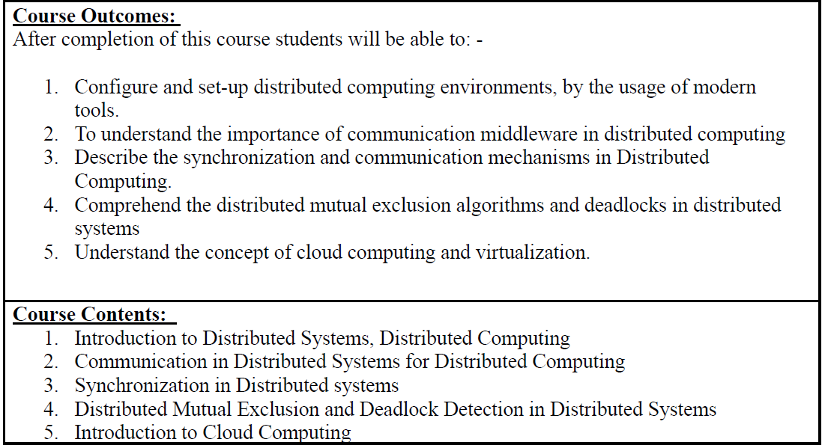

Slide 3
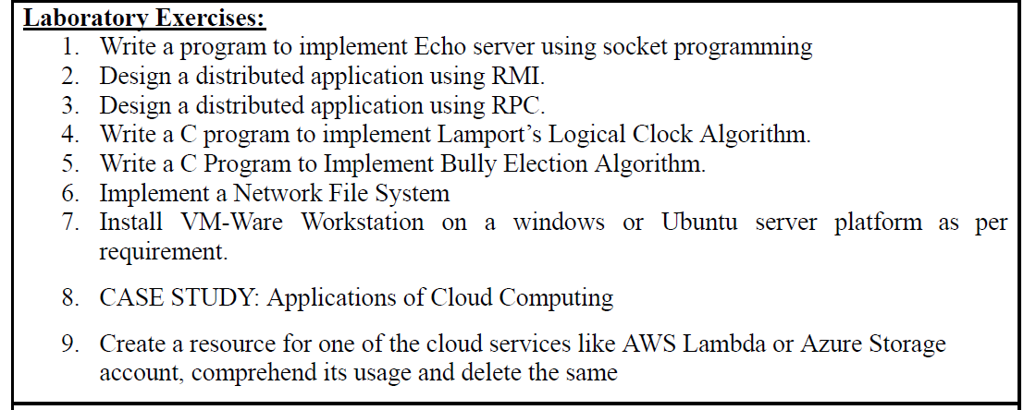
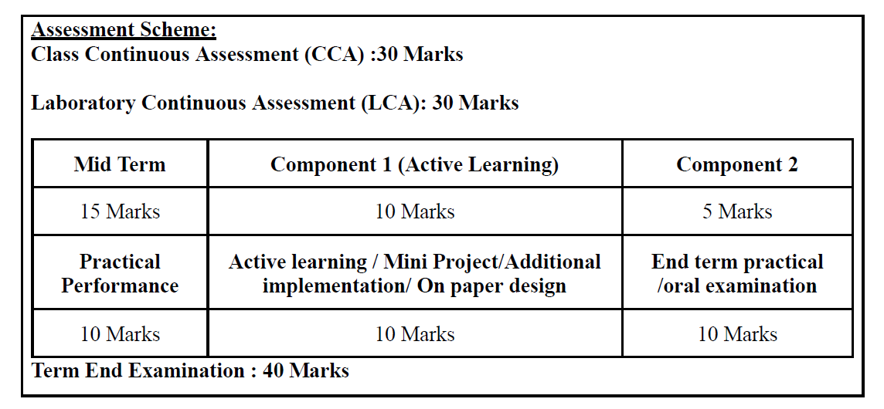

Slide 4
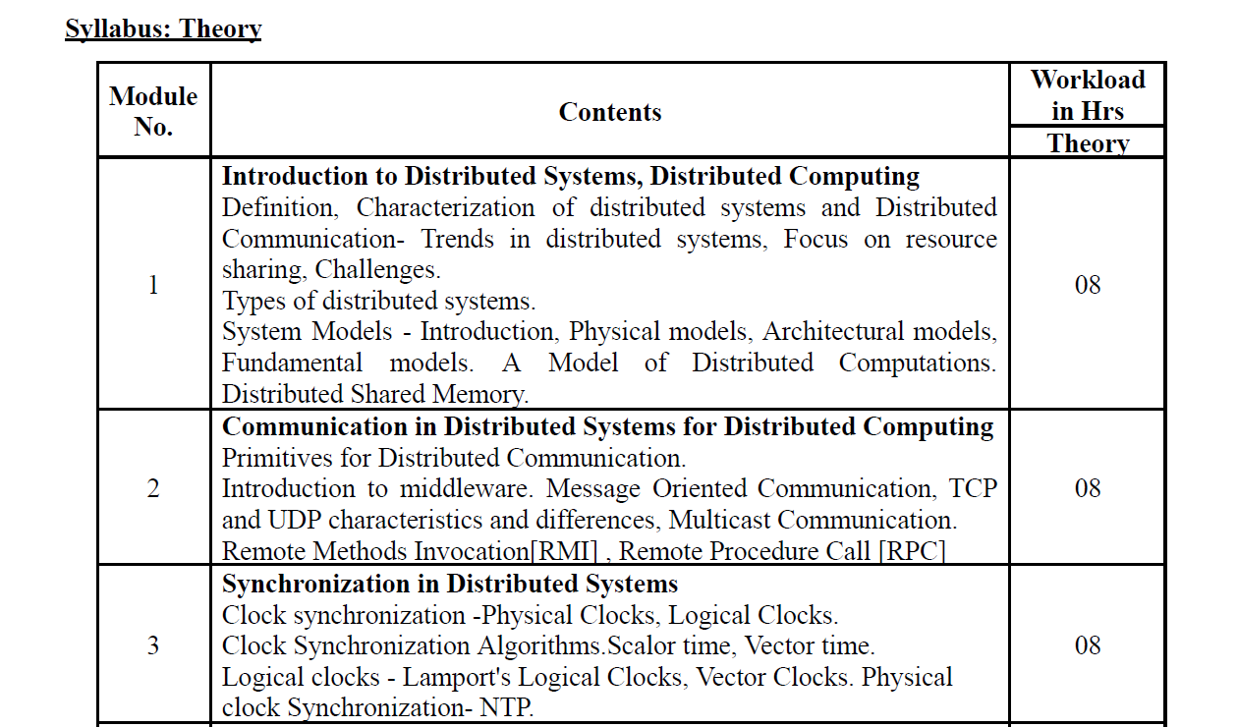

Slide 5
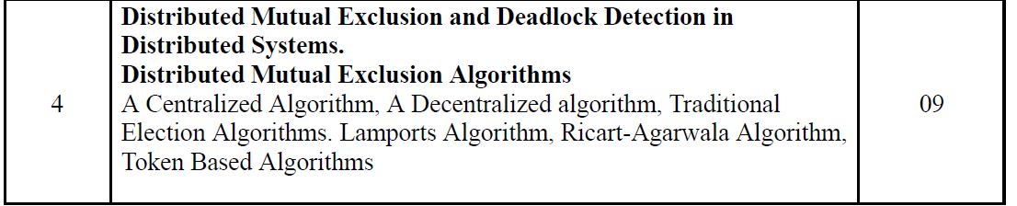
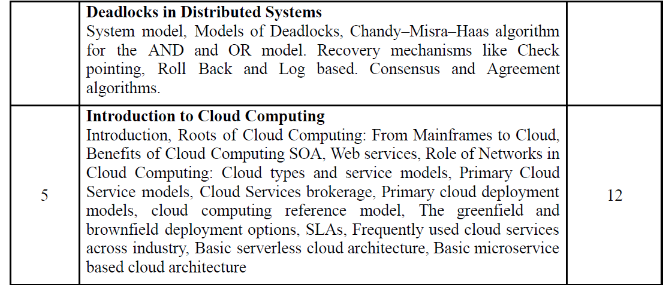

Slide 6
UNIT I
INTRODUCTION TO DISTRIBUTED SYSTEMS, DISTRIBUTED COMPUTING
Definition, Characterization of distributed systems and Distributed
Communication- Trends in distributed systems, Focus on resource
sharing, Challenges.
Types of distributed systems.
System Models - Introduction, Physical models, Architectural models,
Fundamental models. A Model of Distributed Computations.
Distributed Shared Memory.
Notes:
The questions that we try to answer this lecture are:
What is a distributed system, why should we bother to construct systems in a distributed fashion and what are the key properties of a distributed system?

Slide 7
1. WHAT IS A DISTRIBUTED SYSTEM?
Definition: A distributed system is one in which components located at networked computers communicate and coordinate their actions only by passing messages.
Distributed computing system : A distributed computer system consists of multiple software components that are on multiple computers, but it runs as a single system. The computers that are in a distributed system can be physically close together and connected by a local network, or they can be geographically distant and connected by a wide area network.
Notes:
We employ the (adapted) definition of Colouris, Dollimore and Kindberg (2005) of a distributed system.
It requires autonomous computers to be interconnected through a network.
Each computer has to be equipped with distributed operating system software, which enables the computers to coordinate activities and to share resources in a controlled way
We also require transparency of distribution for the computer users. They shall not have to be aware of the fact that the system is distributed.

Slide 8
Distributed Computing systems are many times known simply as Distributed Systems
Distributed computing : a method of computer processing in which different parts of a computer program are run on two or more computers that are communicating with each other over a network.
Distributed Operating System : Software for Distributed Systems

Slide 9
Distributed computing refers to the use of distributed systems to complete computing tasks.
It applies the principles of distributed systems to execute programs on different computer systems connected in a distributed system

Slide 10
1.1 CENTRALIZED SYSTEM CHARACTERISTICS
One component with non-autonomous parts
Component shared by users all the time
All resources accessible
Software runs in a single process
Single point of control
Single point of failure
Notes:
To clarify the consequences of distributing a system, we compare its characteristics to those we find in centralized systems.
In a centralized system, there is a single component that may be decomposed further. However, its parts (such as classes in an object-oriented program) are not autonomous, i.e the component possess full control over them at all times. As there are no other components, there is no need to provide an interface to the component.
If the component supports multiple users (e.g. a relational database), the users share the complete component at all times.
A centralized system runs in a single process. There is no need to take concurrency control and synchronization into account.
There is only a single point of control. The component is in exactly one state that is determined by the program counter of the processor, register variable contents and the virtual memory occupied by the process.
Either the system is running or it is not.Situations cannot occur where part of the system or parts of its interconnection have failed and need to recover.

Slide 11
1.2 DISTRIBUTED SYSTEM CHARACTERISTICS
Multiple autonomous components
Components are not shared by all users
Resources may not be accessible
Software runs in concurrent processes on different processors
Multiple points of control
Multiple points of failure
Notes:
In a distributed system, there are multiple components that may be decomposed further. These components are autonomous, i.e. they possess full control over their parts at all times. The components, however, have to provide interfaces to be able to use each other.
There may be components that are used by only some users but are not used by others. It is then beneficial to have these components residing on machines that are local to the users that use them.
A distributed system runs in multiple processes. These processes are usually not executed on the same processor. Hence inter-process communication involves communication with other machines through a network. Different levels of abstraction (confer the ISO/OSI reference model) are involved in this communication.
There are multiple points of control, but these are not totally independent. Components have to take into account that they are being used by other components and have to react properly to requests.
There are multiple points of failure in a distributed system. The system may fail because a component of the system has failed. It may also fail if the network has broken down. It may also fail if the load on a component is so high that it does not respond within a reasonable time frame. Even so, the distributed system is more fault-tolerant than a centralized one.

Slide 12
2. EXAMPLES OF DISTRIBUTED SYSTEMS
Local Area Network and Intranet
Database Management System
Automatic Teller Machine Network
Internet/World-Wide Web
Mobile and Ubiquitous Computing
Notes:
We now review several systems that most of you have come across already (possibly without being aware that they are distributed).
This review will provide you with a better understanding of the issues that are to be tackled during distributed systems construction.

Slide 13
A distributed system consists of a collection of autonomous computers linked by a computer network and equipped with a distributed software enables computers to coordinate their activities and to share resources of the systems.
Distributed computing is a computing concept that, in its most general sense, refers to multiple computer systems working on a single problem.
In distributed computing, a single problem is divided into many parts, and each part is solved by different computers.
As long as the computers are networked, they can communicate with each other to solve the problem. If done properly, the computers perform like a single entity.

Slide 14
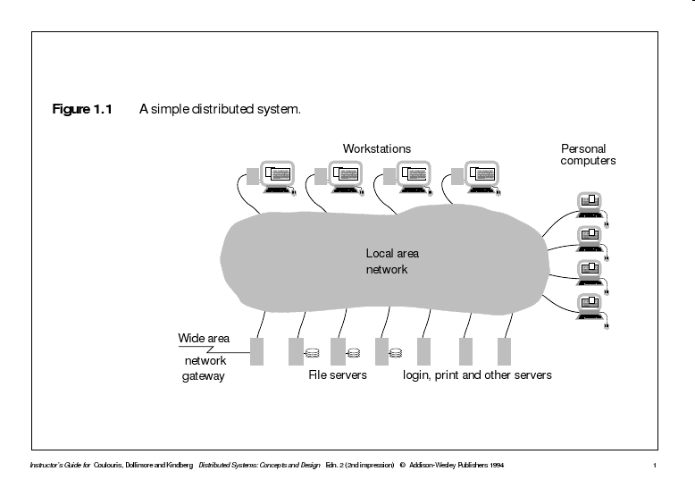
A Distributed System

Slide 15
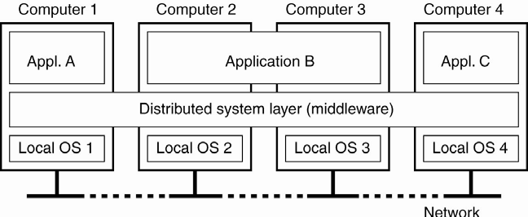
A Distributed System

Slide 16
3. COMMON CHARACTERISTICS
What are we trying to achieve when we construct a distributed system?
Certain common characteristics can be used to assess distributed systems
  Heterogeneity
  Openness
  Security
  Scalability
  Failure Handling
  Concurrency
  Transparency
Notes:
Why do we bother about constructing distributed systems? Constructing a centralized system appears to be much easier!
Some properties of a distributed system cannot be achieved by a centralized system. It is worthwhile to keep these properties in mind during the design or assessment of a distributed system.
Heterogeneity: I can access all the documents that are available on the Internet, even though the documents are located in different type of machines.
Openness: I have credit cards from Hang Seng Bank and Wells Fargo Bank in U.S.A. and can use them at each others tellers. These banks, however, would never develop a common centralized teller system. It is because their systems are open and interoperable that I have this flexibility.
Security: I want to purchase products in e-Commerce. I don’t want other people to steal my credit card number.
Scalability: Distributed systems, such as the Internet, grow each day to accommodate more users and to withstand higher load. (Hong Kong stock trading broker is on-line and you can open accounts and do on-line trading from home PC).
Failure Handling: Two (distributed) account databases are managed by the bank to quickly recover from a break-down.
Concurrency: Multiple database users can concurrently access and update data in a distributed database system. The database system preserves integrity against concurrent updates and users perceive the database as their own copy. They are, however, able to see each others changes after they have been completed.
Transparency: When using a distributed system it appears to users as if it were centralized.

Slide 17
3.1 HETEROGENEITY
Variety and differences in
  Networks
  Computer hardware
  Operating systems
  Programming languages
  Implementations by different developers
Middleware as software layers to provide a programming abstraction as well as masking the heterogeneity of the underlying networks, hardware, OS, and programming languages (e.g., CORBA).
Mobile Code to refer to code that can be sent from one computer to another and run at the destination (e.g., Java applets and Java virtual machine).
Notes:
The Internet enables users to access services and run applications over a heterogeneous collection of computers and networks.
Heterogeneity applies to
Networks
Computer hardware
Operating systems
Programming languages
Implementations by different developers
Differences of heterogeneous components in a distributed system have to be resolved
Differences in data type representation regarding, for example, byte ordering of integers
Different APIs of different operating systems for the implementation of the Internet protocols
Different programming languages use different representations for characters and data structures such as arrays and records
Different programmers have to common standards for communication purpose
Middleware helps to solve the problems of heterogeneity. It also provides a uniform computational model for use by the programmers of servers and distributed applications.
Mobile code is used to be run on heterogeneous computers. To get it done, the virtual machine approach provides a way of making code executable on any hardware: the compiler for a particular language generates code for a virtual machine instead of a particular hardware order code.

Slide 18
3.2 OPENNESS
Openness is concerned with extensions and improvements of distributed systems.
Detailed interfaces of components need to be published.
New components have to be integrated with existing components.
Differences in data representation of interface types on different processors (of different vendors) have to be resolved.
Notes:
Openness tries to address the following question: How difficult is it to extend and improve a system.
Most often functional extensions and improvements require new components to be added.
These components may have to use the services provided by existing components.
Hence, the static and dynamic properties of services provided by components have to be published in detailed interfaces.
The new components have to be integrated into existing components, so that the added functionality becomes accessible from the distributed system as a whole.
Components may not always be running on the same platforms. Hang Seng Bank, HongKong Bank, and Bank of China almost certainly do not have the same type of hosts, it´s quite likely they use different programming languages and have different networks. Still their automatic teller machines have to be integrated.
To achieve such an heterogeneous integration, often different data representation formats have to be integrated. If components running on a Windows-3.x PC have to be integrated with components running on a Sun SparcStation, short integers on the Sun have 64 bit, while they only have 16 bit on the PC. Some mainframes revert the order in which 2 byte numbers are stored, most don´t.

Slide 19
3.3 SECURITY
In a distributed system, clients send requests to access data managed by servers, resources in the networks:
  Doctors requesting records from hospitals
  Users purchase products through electronic commerce
Security is required for:
  Concealing the contents of messages: security and privacy
  Identifying a remote user or other agent correctly (authentication)
New challenges:
  Denial of service attack
  Security of mobile code
Notes:
Many needs for security exist for distributed systems for data secrecy and personal privacy.
Security is also required for authentication purpose.
Many challenges in security exist in modern distributed systems. Denial of service attack and mobile code security are two examples.

Slide 20
3.4 SCALABILITY
Adaptation of distributed systems to
  accommodate more users
  respond faster (this is the hard one)
Usually done by adding more and/or faster processors.
Components should not need to be changed when scale of a system increases.
Design components to be scalable!
Notes:
Centralized systems often create bottlenecks as soon as a certain number of users are reached.
Distributed systems can be built in a way that these bottlenecks are avoided.
Then new processors can be added to accommodate new users. The Internet grows every day by adding new sites.
Other internet sites are not affected by these additions. They do not have to be changed.
However, components in distributed systems have to be designed in a way that the overall system remains scalable.
Sometimes it is required to relocate components, i.e. to migrate them to new processors. Relocation is required to populate new processors with components and to remove a certain amount of load from existing processors.
Then it is important that no or only very little assumptions are made on the location of components, both within the component itself and also within other components that use the component. Otherwise these components having explicit location information have to be changed whenever a component is relocated.

Slide 21
3.5 FAILURE HANDLING (FAULT TOLERANCE)
Hardware, software and networks fail!
Distributed systems must maintain availability even at low levels of hardware/software/network reliability.
Fault tolerance is achieved by
  recovery
  redundancy
Notes:
Hardware, software and networks are not free of failures. They fail either because of software errors, failures in the supporting infrastructure (power-supply or air-conditioning), mis-use of their users or just because of aging hardware. The average life time of hard disks are between two and five years, much less than the average life-time of a distributed system.
Given that there are many processors in a distributed system, it is much more likely that one of them fails than it is that a centralized system fails.
Distributed system, therefore, have to be built in a way that they continue to operate, even in the presence of failures of some of its components.
A distributed system can even achieve a higher reliability than a centralized system if distribution and replication is exploited properly.
Two different means have to be deployed to achieve fault tolerance: recovery and redundancy.
Components that are able to recover from failures have been built in a way that they react in a controlled way if they rely on services of components that have failed.
Redundant hardware, software and data decreases the time that is needed after a failure to bring a system up again.

Slide 22
3.6 CONCURRENCY
Components in distributed systems are executed in concurrent processes.
Components access and update shared resources (e.g. variables, databases, device drivers).
Integrity of the system may be violated if concurrent updates are not coordinated.
  Lost updates
  Inconsistent analysis
Notes:
Components in distributed systems are executed concurrently. There may be many different people at different teller machines. Likewise, there are many different users working in a local area network.
While these components access shared resources, the resources have to be protected against integrity violations that may be introduced through concurrency.
As an example for a lost update, consider that you withdraw 50 dollars. This requires the bank´s account database to compute:
debitbalance = balance-50; /* Op1 */
balance = debitbalance; /* Op2 */
If a clerk in the bank credits a check of 100 dollars the following computation has to be done:
creditbalance = balance+100; /* Op3 */
balance = creditbalance; /* Op4 */
If these two modifications to your account are done concurrently the integrity of the account data may be violated in two ways:
1. your debit may not be recorded (bad luck for the bank) if the schedule is (Op1, Op3, Op2, Op4).
2. the credit of your check may not be recorded (bad luck for you) if the schedule is (Op3, Op1, Op4, Op2).
These situations have by all means to be avoided.
Concurrency control facilities (such as locking) are needed in almost any concurrent system.

Slide 23
3.7 TRANSPARENCY
Distributed systems should be perceived by users and application programmers as a whole rather than as a collection of cooperating components.
Transparency has different aspects.
These represent various properties that distributed systems should have.
Notes:
The complexity of distributed systems should be hidden from their users. They should not have to be aware whether the system they are using is centralized or distributed. Thus, it is transparent for the user that s/he is using a distributed system.
For the administrators of the system, however, this is not true. For them, it may well be important (e.g. during load balancing) to know which component resides on which machine.
To make life easier for an application programmer, s/he should also not have to be aware that s/he is using distributed components.
You have certainly developed a program on a CSE machine where you had to use the file system. You were able to use the same library for file access irregardless whether the files were stored on local or remote file systems. Most likely, you were storing files on remote disks, however, and you may even not have been aware of that. Thus distribution was both access and location transparent for you as an application programmer.
There are many aspects of transparency, which we will discuss now. Transparency is, in fact, orthogonal to the other characteristics that we have discussed so far and applies to most of them. We will, therefore, have a closer look now at access transparency, location transparency, concurrency transparency, replication transparency, failure transparency, mobility transparency, performance transparency and scaling transparency.

Slide 24
3.7.1 ACCESS TRANSPARENCY
Enables local and remote information objects to be accessed using identical operations.
Example: File system operations in NFS.
Example: Navigation in the Web.
Example: SQL Queries
Notes:
Access transparency means that the operations or commands that are used for accessing objects are identical irregardless whether local or remote data is being accessed.
Examples of access transparency are:
Users of UNIX NFS can use the same commands for copying, moving and deleting files irregardless whether the accessed files are local or remote.
Application programmers can use the same library calls to manipulate files on NFS.
Users of a web browser can navigate to another page by clicking on a hyperlink, irregardless whether the hyperlink leads to a local or a remote page.
Programmers of a database application can use the same SQL commands irregardless whether they are accessing a local or a remote database in a distributed relational database management system.

Slide 25
3.7.2 LOCATION TRANSPARENCY
Enables information objects to be accessed without knowledge of their location.
Example: File system operations in NFS
Example: Pages in the Web
Example: Tables in distributed databases
Notes:
Location transparency means that data can be accessed without knowing the physical position of the data.
Examples
Users of the network file system can access files by name and do not need to know whether the file resides on a local or a remote disk.
The same applies to application programmers, who can pass file names to library functions and need not worry about the physical location of the files.
Users of a Web browser need not be aware where the page physically resides. They can access initially pages by a URL and then can navigate further by URLs that are embedded in the web page.
Programmers of a relational database application do not need to worry where the tables physically reside. They can access tables by table name and need not worry about where the table is physically located. Their local database monitor will translate the names into physical location and have remote monitors transferring tables if a remote table should be accessed.

Slide 26
3.7.3 CONCURRENCY TRANSPARENCY
Enables several processes to operate concurrently using shared information objects without interference between them.
Example: NFS
Example: Automatic teller machine network
Example: Database management system
Notes:
Enables several processes to concurrently access and update shared information without having to be aware that other processes may be accessing the information at the same time.
Examples:
Multiple users can access and update files on the same file system and they do not know about each other.
Concurrency is, however, not transparent for an application programmer using the file system. To avoid lost updates and inconsistent analysis, s/he has to explicitly lock files.
Users of an automatic teller machine need not be aware of the fact that other customers are using tellers at the same time and that bank clerks may be concurrently manipulating account balances.
Programmers of relational database applications typically need not worry about concurrency, but integrity against concurrent updates is typically preserved by the database management system (e.g. by two-phase locking).

Slide 27
3.7.4 REPLICATION TRANSPARENCY
Enables multiple instances of information objects to be used to increase reliability and performance without knowledge of the replicas by users or application programs
Example: Distributed DBMS
Example: Mirroring Web Pages.
Notes:
Replication is the duplication of data on other hosts
Replication is used to increase the reliability of data accesses as well as the performance with which data is accessed and updated.
Replication transparency denotes the fact that neither users nor application programmers have to be aware about the replication of data.
Examples:
Tables in a distributed relational database may be replicated. However neither users, nor application programmers are aware that the tables are replicated and updates have to be propagated to the other replicas as well.
Often Web pages are replicated to increase performance of their retrieval and to have them available also in the presence of network failures. The SuperJanet gateway, for instance replicates pages from the US that are frequently accessed. Replication, however, is transparent for both Web surfers and Web page designers. A Web surfer does not see that the page is not being brought over the Atlantic (S/he may be surprised by the speed, however). A Web page designer can still refer to the US URL and need not take the mirror site into account.

Slide 28
3.7.5 FAILURE TRANSPARENCY
Enables the concealment of faults
Allows users and applications to complete their tasks despite the failure of other components.
Example: Database Management System
Notes:
Even though components in distributed systems may fail, it is important that users of the systems are not aware of these failures. Failure Transparency denotes this concealment of failures.
Failure transparency is rather difficult to achieve. It involves complete fault recovery.
As an example, consider the distributed database again. If the database has kept local replicates of remote data, users can continue to use the database, even though the remote data monitors have failed. The local data monitor has to detect the failure of remote monitors. Updates of local data then have to be buffered in the local replicate, inconsistencies have to be temporarily tolerated (as multiple sites may temporarily buffer updates). After the remote monitor has come up again, the buffered updates have to be incorporated into the remote databases and inconsistencies (if any) have to be reconciled.

Slide 29
3.7.6 MOBILITY TRANSPARENCY
Allows the movement of information objects within a system without affecting the operations of users or application programs
Example: NFS
Example: Web Pages
Notes:
Migration denotes the fact that software and/or data is moved to other processors.
Migration is transparent to users and application programmers if they do not have to be aware of the fact that software and/or data has moved.
Migration transparency is dependent on location transparency.
Examples:
If CSE decides to move file systems of the NFS (or parts thereof) to a different disk, you will not recognize that.
If CSE moves the department Web site to a different location in the file system, you will not recognize that because the URL http://www.cse.cuhk.edu.hk will be interpreted by the local http daemon.

Slide 30
3.7.7 PERFORMANCE TRANSPARENCY
Allows the system to be reconfigured to improve performance as loads vary.
Example: Distributed make.
Notes:
Performance Transparency denotes the fact that users and application programmers are not aware as to how the performance that a distributes system has is actually achieved.
Example: There is a variant of make that is capable of performing jobs (e.g. compiling a source module) on remote machines. Then complex systems can be compiled much quicker. It not only considers the different processors and their capabilities, but also their actual load. If it can choose from a set of processors, it will delegate it to the fastest processor that has the lowest load. In this way it achieves an even better performance. Programmers using make, however, do not see or choose which machine performs which job. The way how the actual performance is achieved is transparent for them.

Slide 31
3.7.8 SCALING TRANSPARENCY
Allows the system and applications to expand in scale without change to the system structure or the application algorithms.
Example: World-Wide-Web
Example: Distributed Database
Notes:
Scalability denotes the fact that the distributed system can be adjusted to accommodate a growing load / number of users.
Scaling the distributed system up is transparent if users and application programmers do not have to be changed.
Examples:
New Web sites can be added to the Internet, thus scaling the Internet up without existing sites having to change their set-up.
New network connections can be added in the Internet or existing connections are replaced with higher bandwidth connections to improve throughput. Existing Web sites do not have to be changed to benefit from this improvement.
In a distributed database, new hosts can be added to accommodate parts of the database. The allocation tables maintained by database monitors will have to be adjusted. Existing database schemas and applications, however, need not be changed.

Slide 32
4. BASIC DESIGN ISSUES
General software engineering principles include rigor and formality, separation of concerns, modularity, abstraction, anticipation of change, …
Specific issues for distributed systems:
  Naming
  Communication
  Software structure
  System architecture
  Workload allocation
  Consistency maintenance
Notes:
According to the Fundamentals of Software Engineering book by Ghezzi et. al., software engineering principles include (1) Rigor and Formality (2) Separation of Concerns (3) Modularity (4) Abstraction (5) Anticipation of Change (6) Generality and (7) Incrementality.
Specific issues need to be resolved for the design of software for distributed systems.

Slide 33

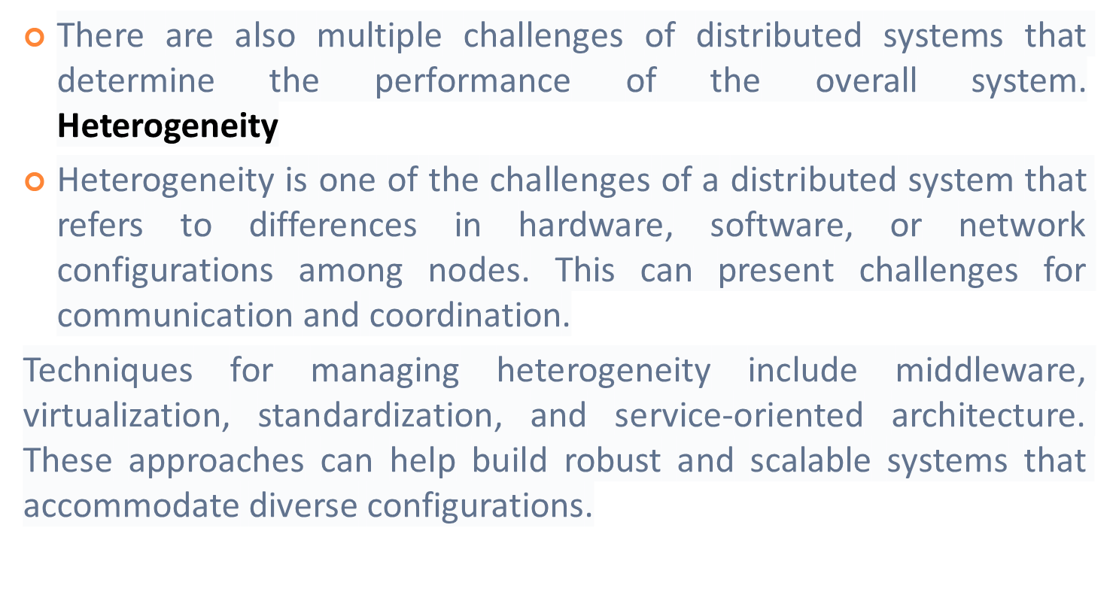

Slide 34
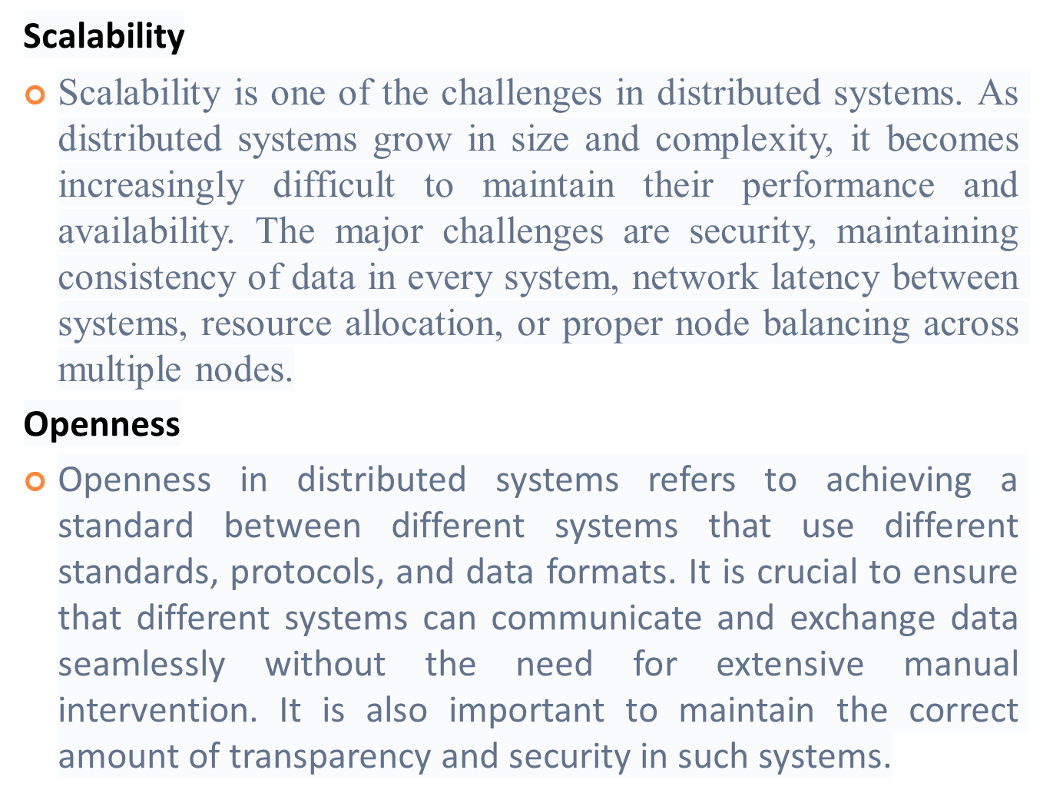

Slide 35
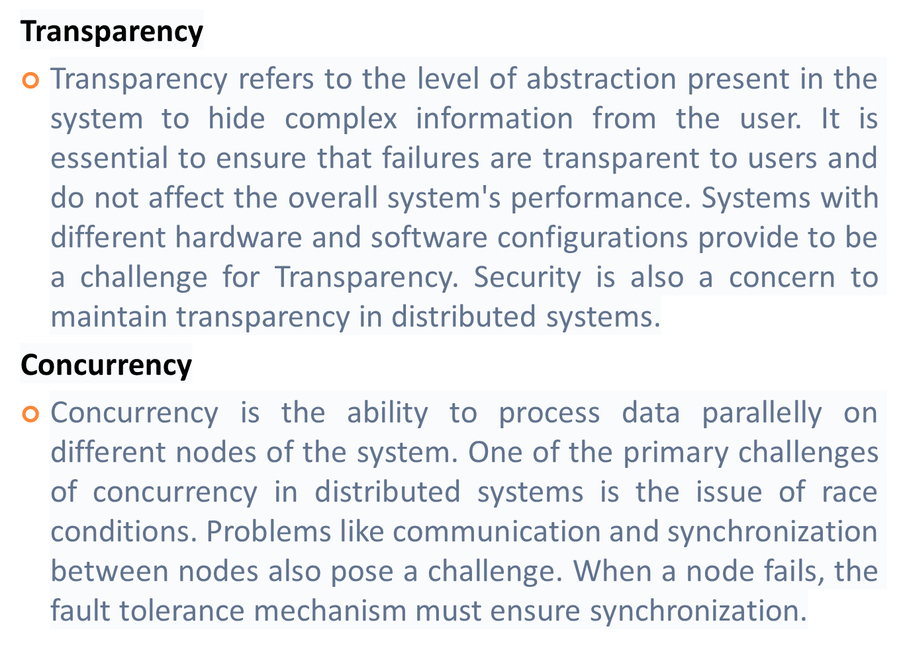

Slide 36
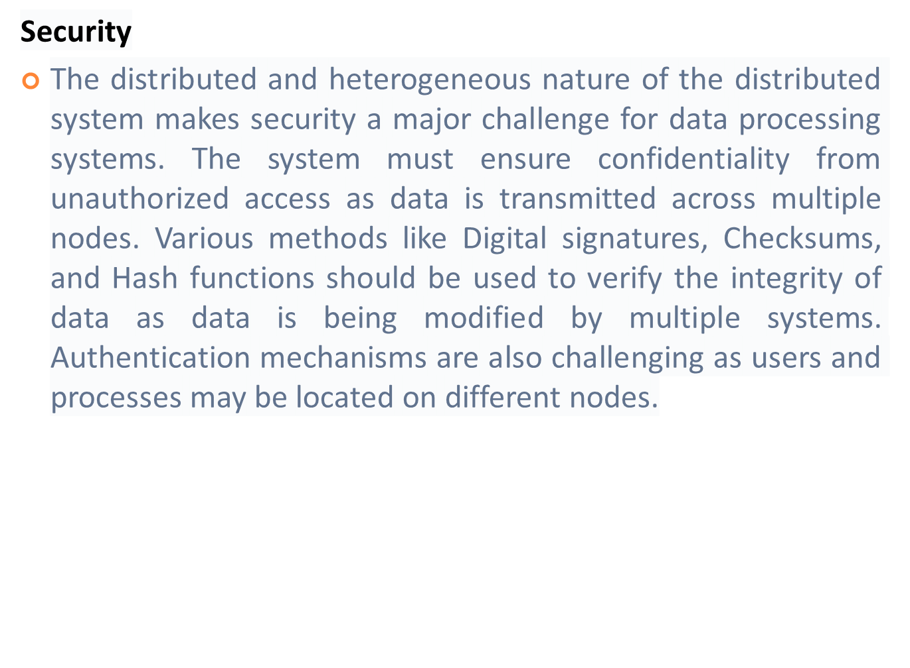

Slide 37
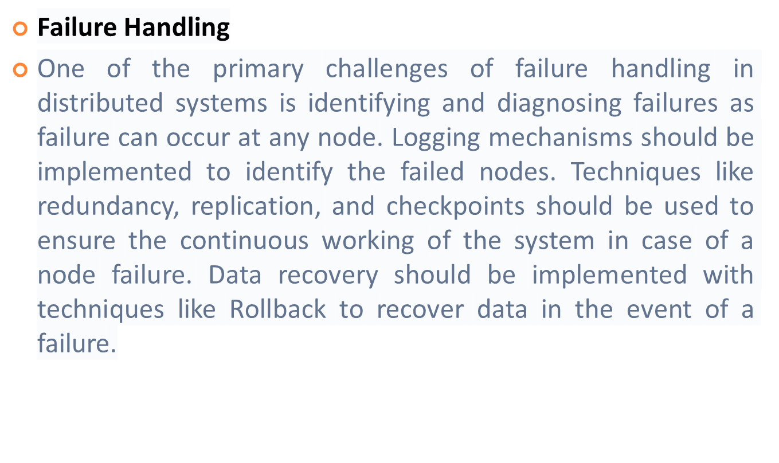

Slide 38
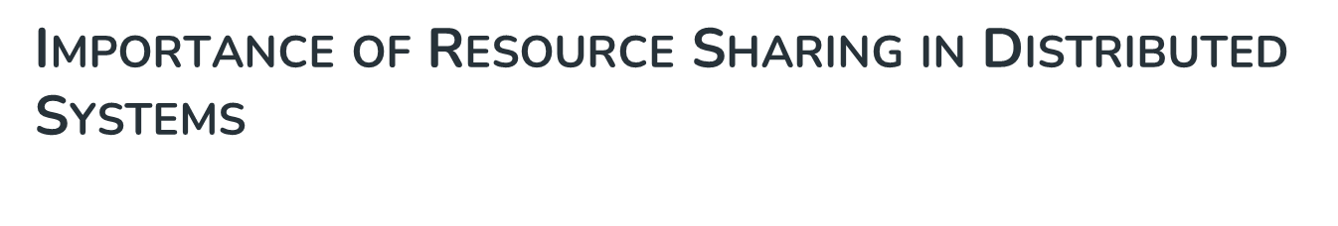
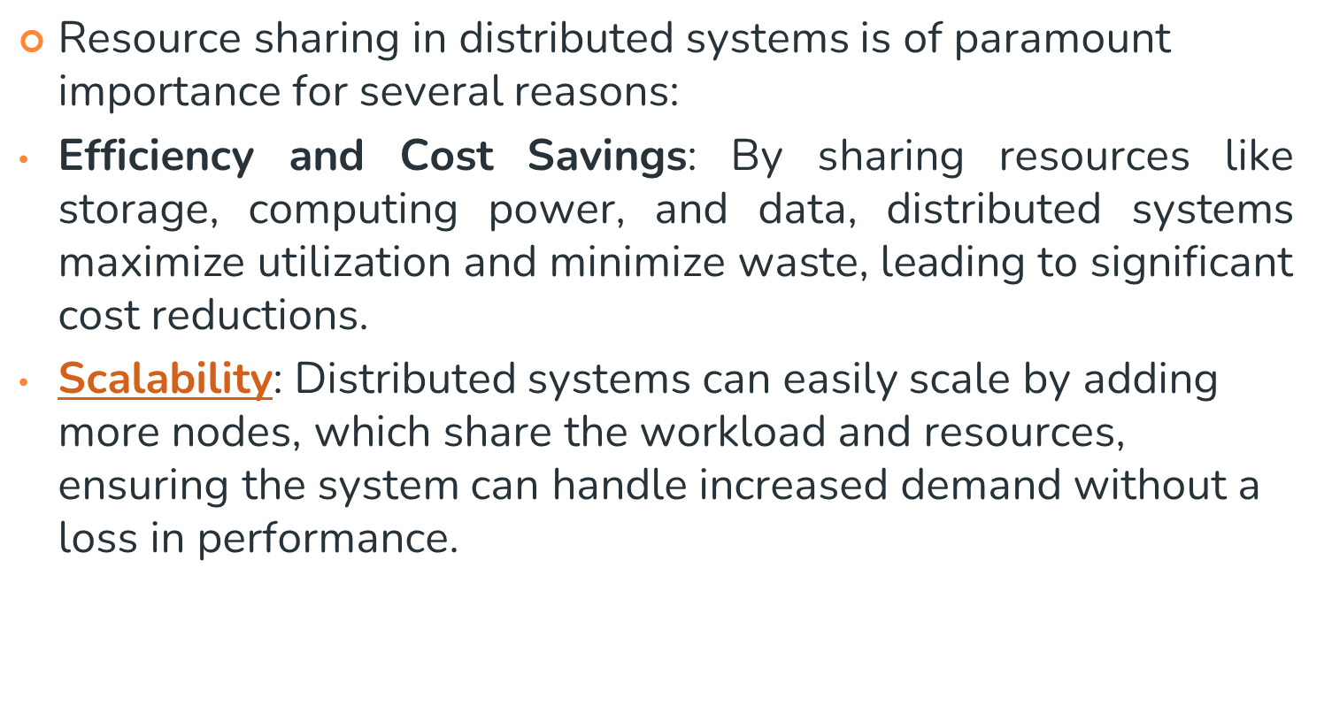

Slide 39
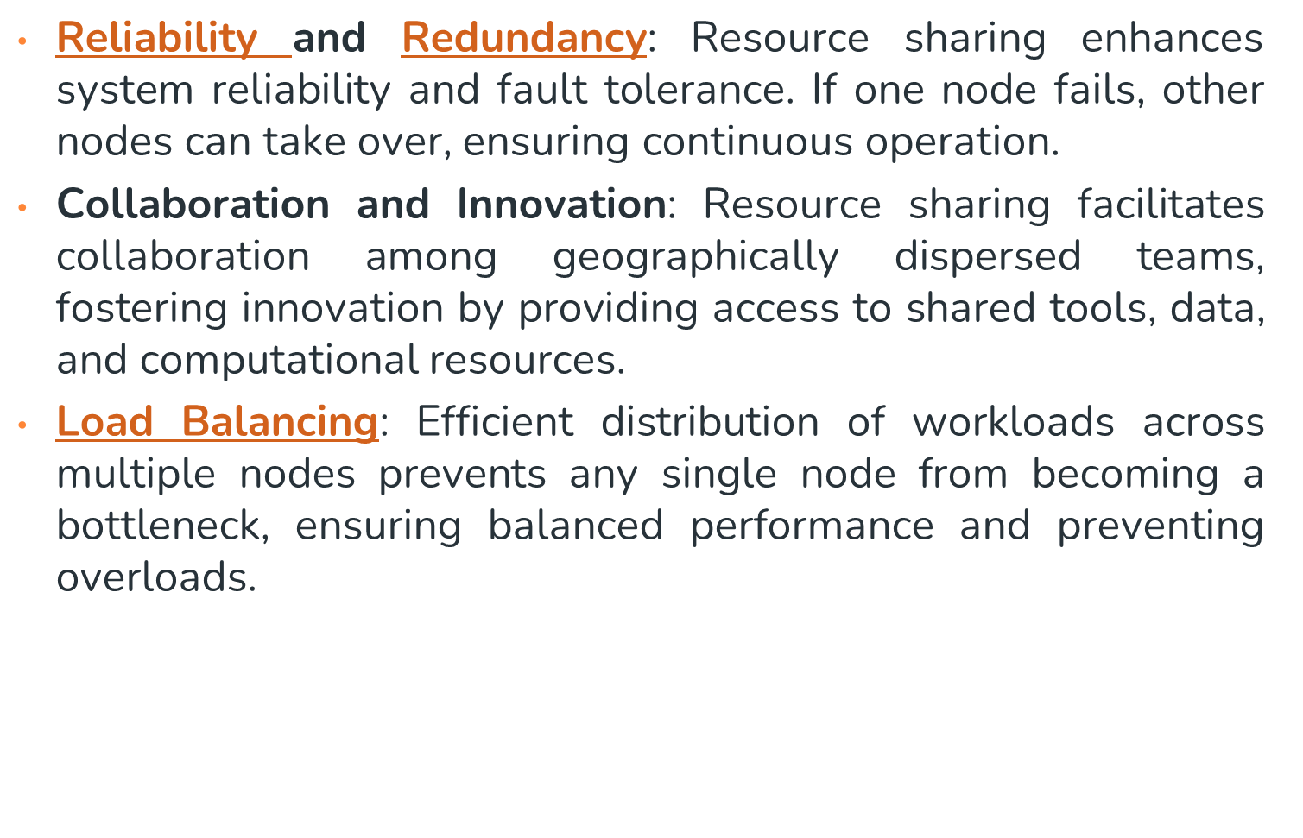

Slide 40
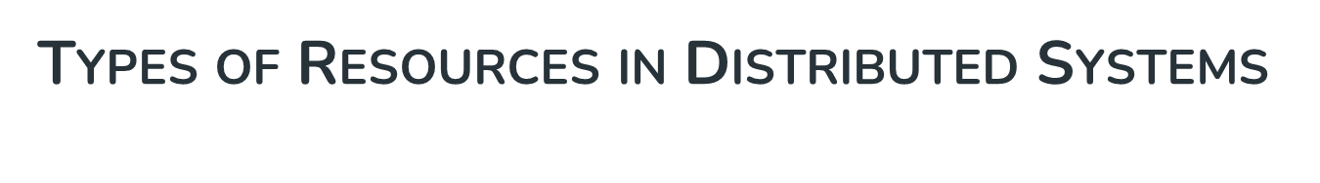
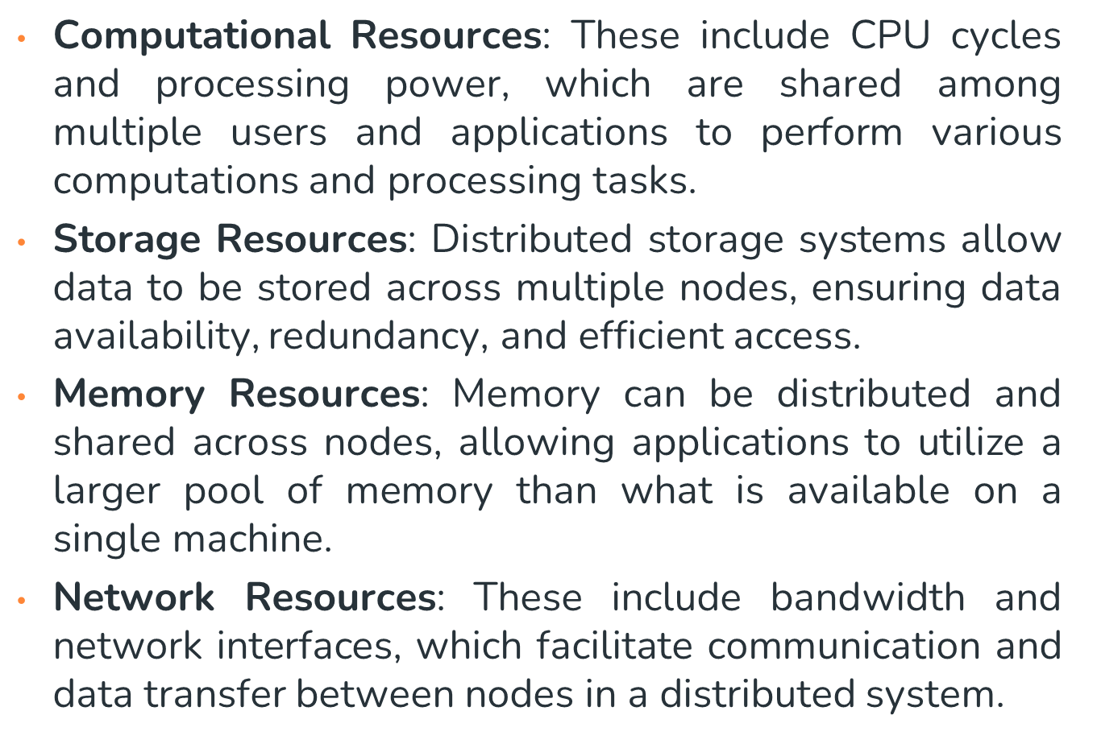

Slide 41
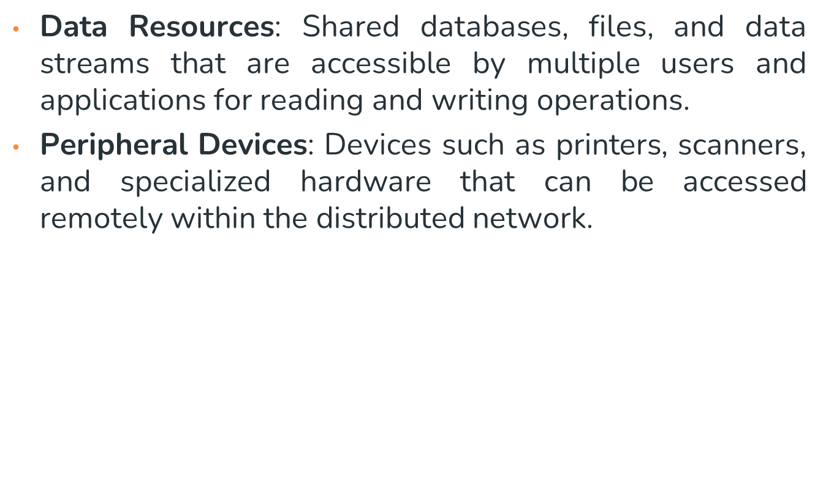

Slide 42

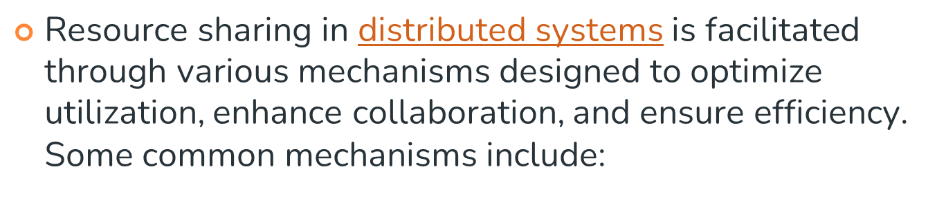
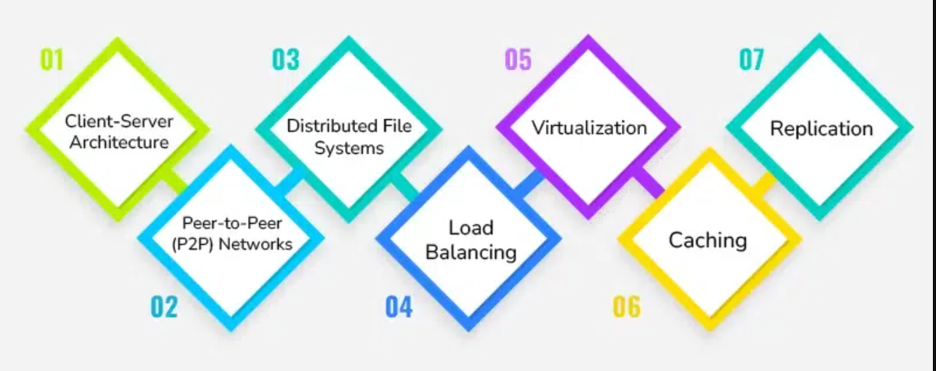

Slide 43
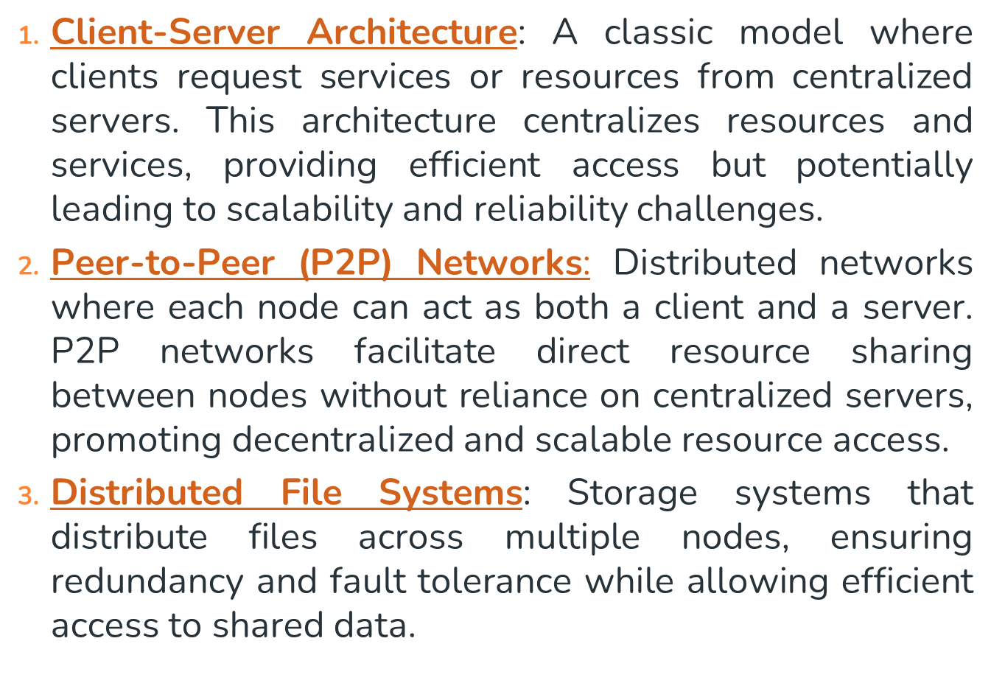

Slide 44
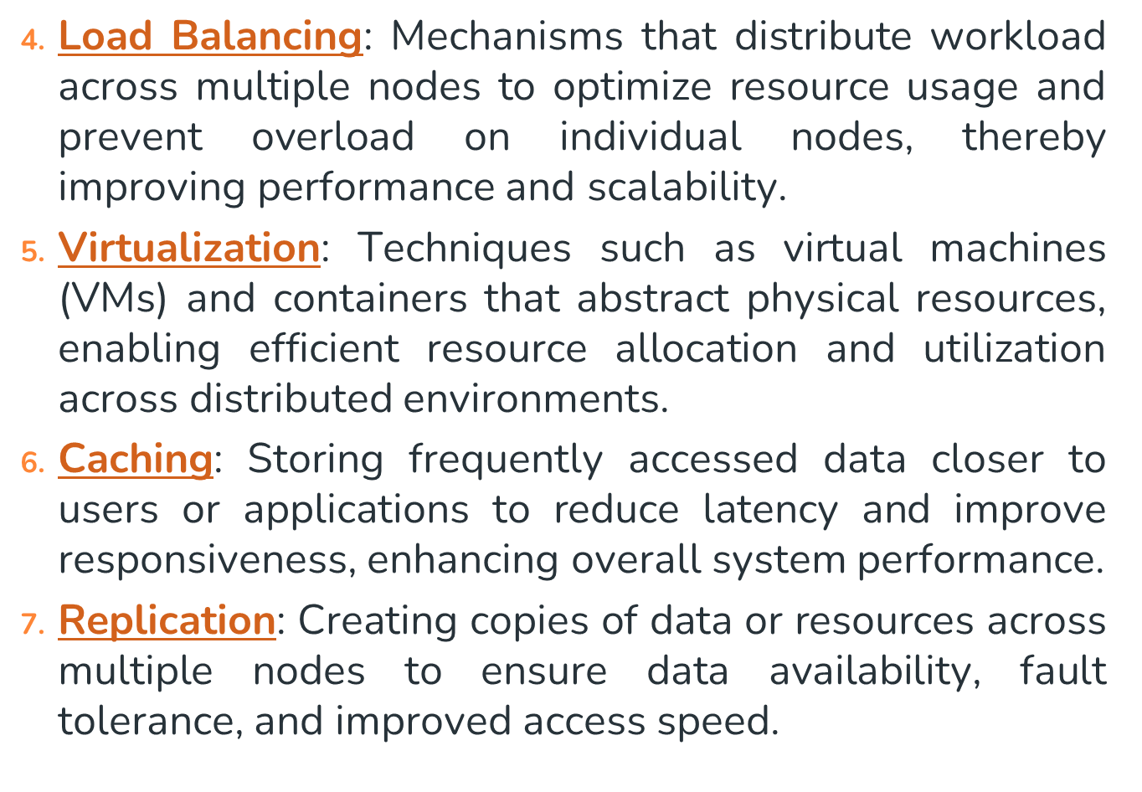

Slide 45
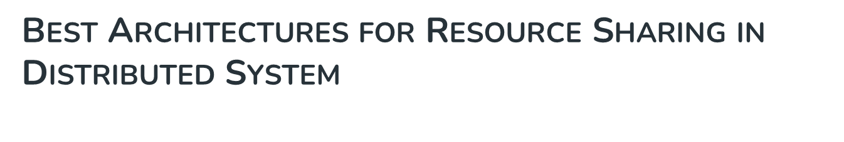
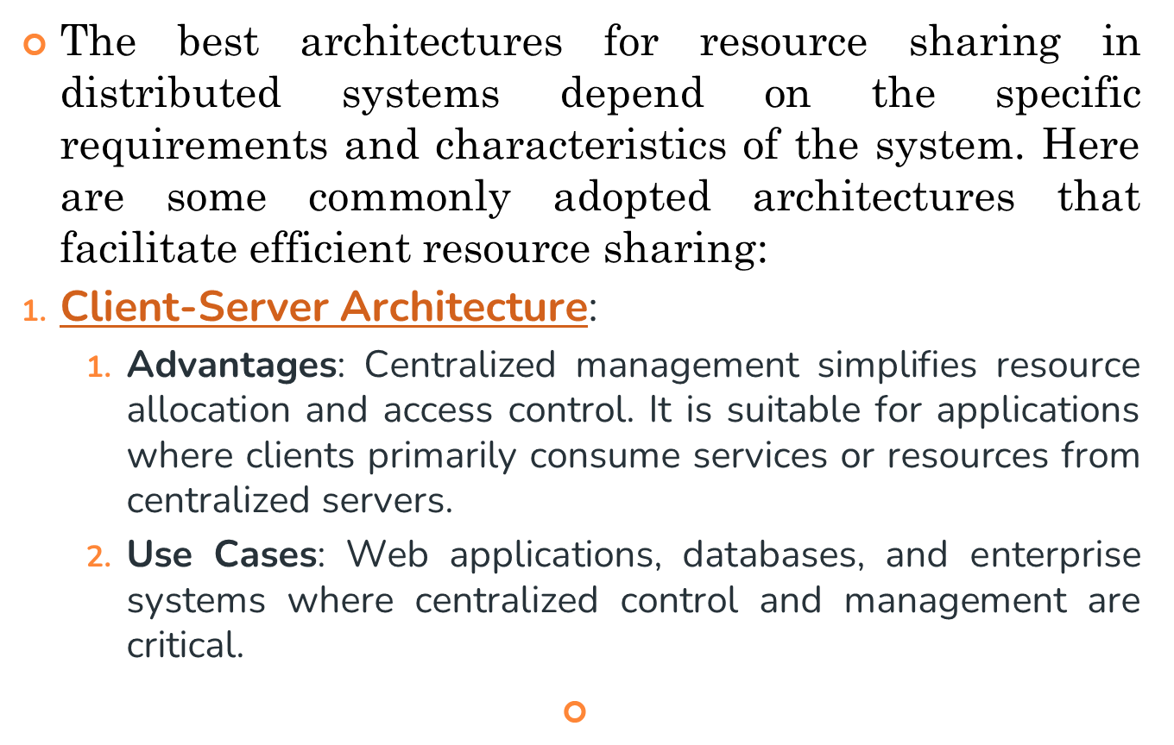

Slide 46
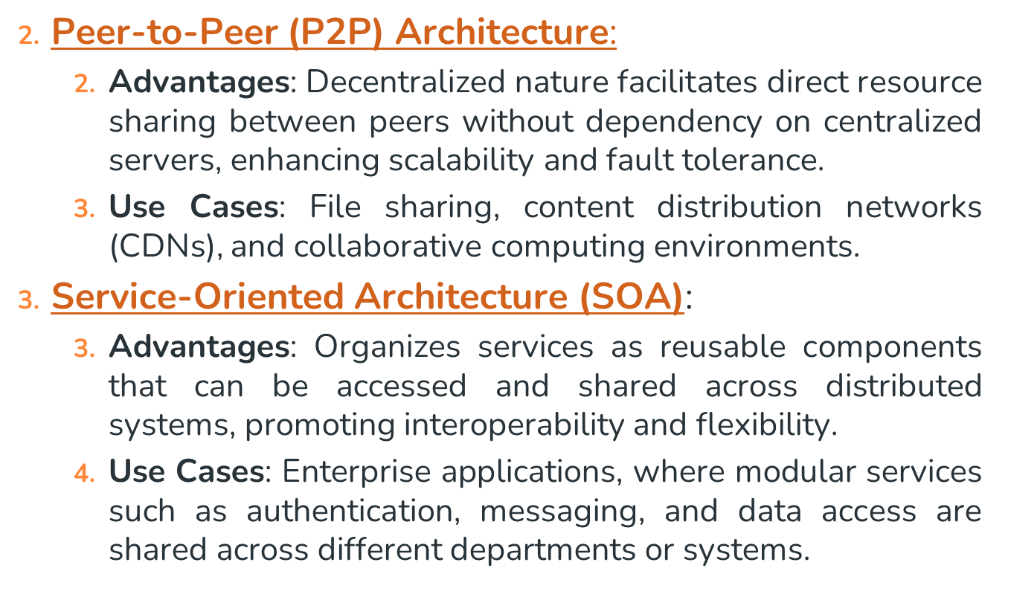

Slide 47
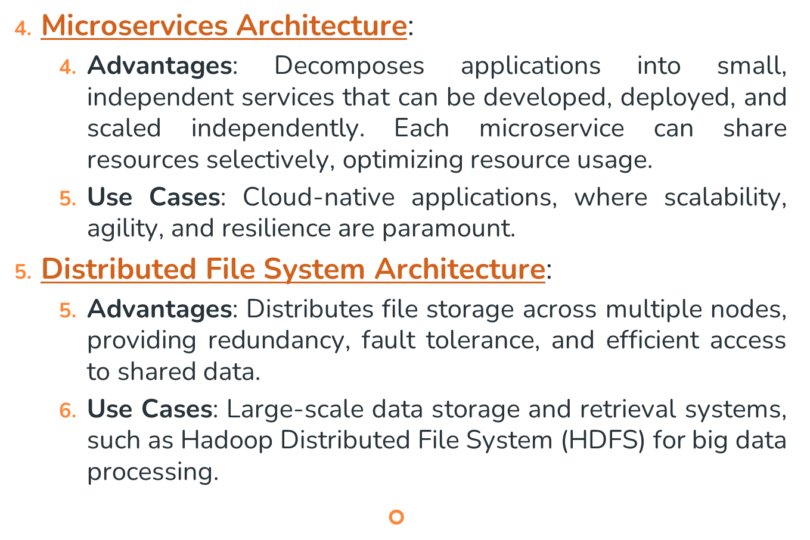

Slide 48
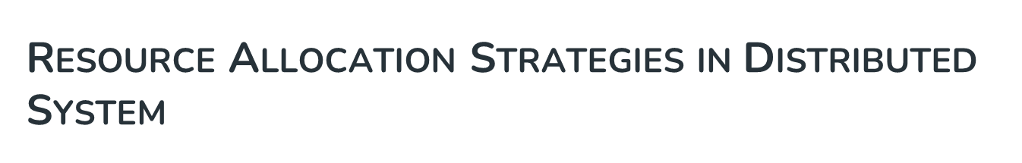
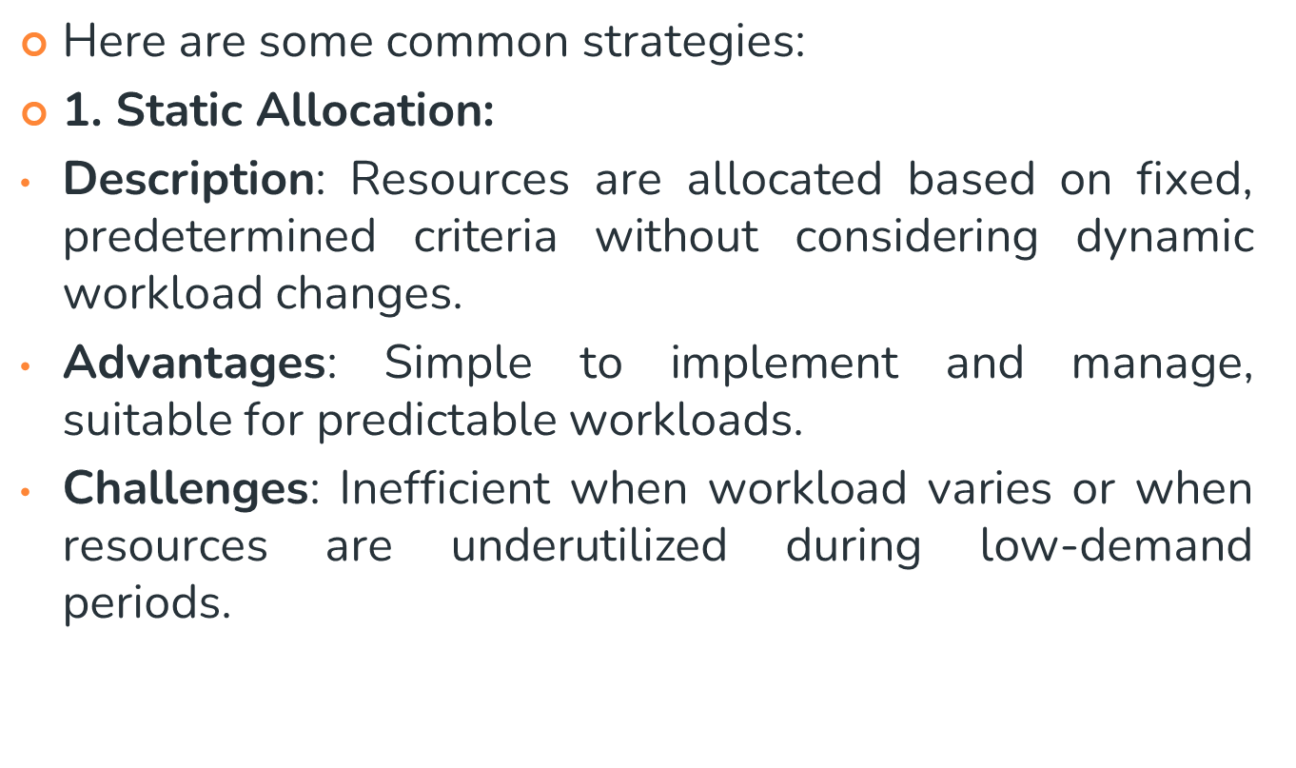

Slide 49
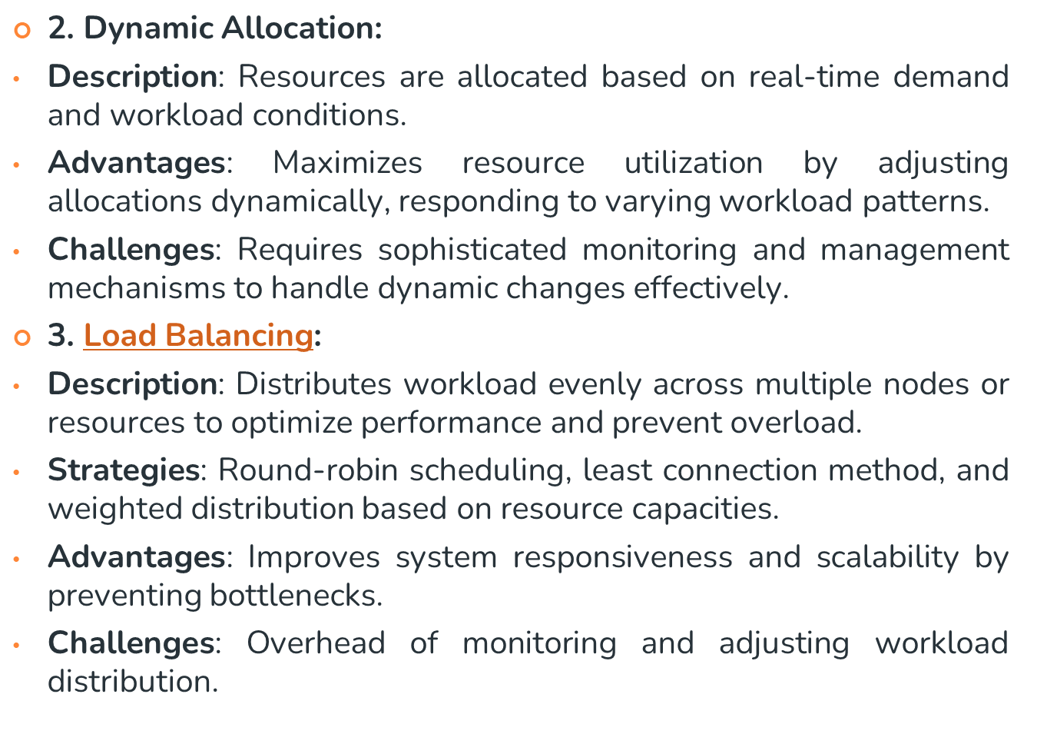

Slide 50
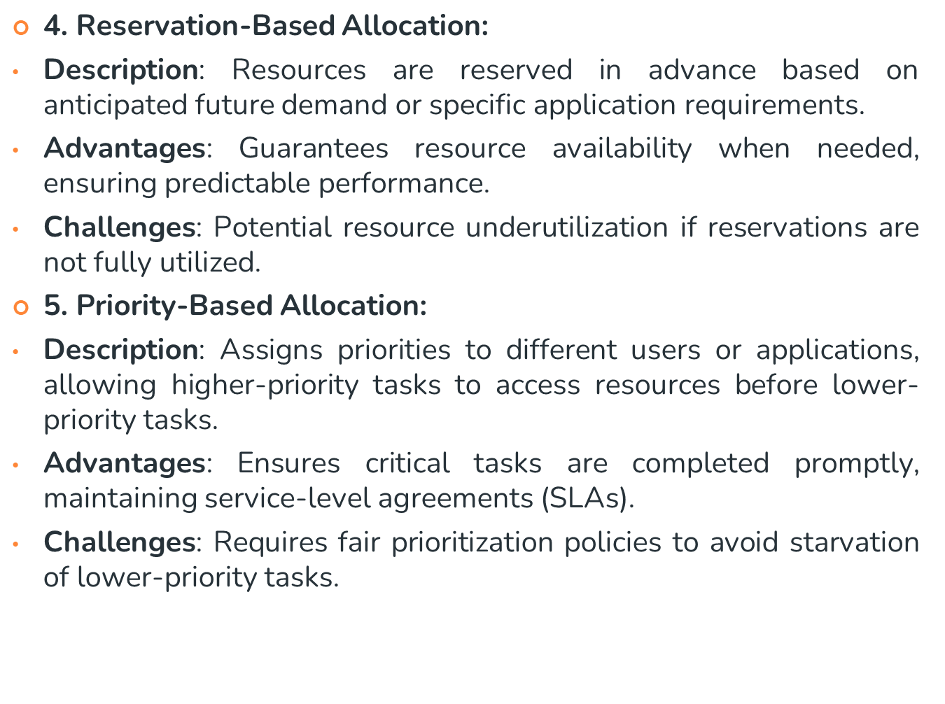

Slide 51
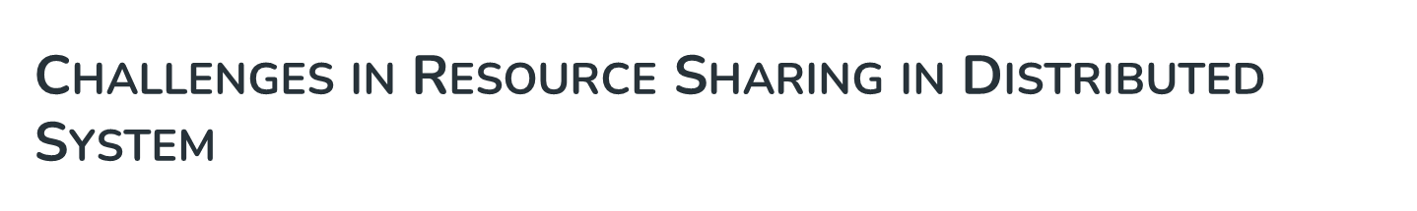
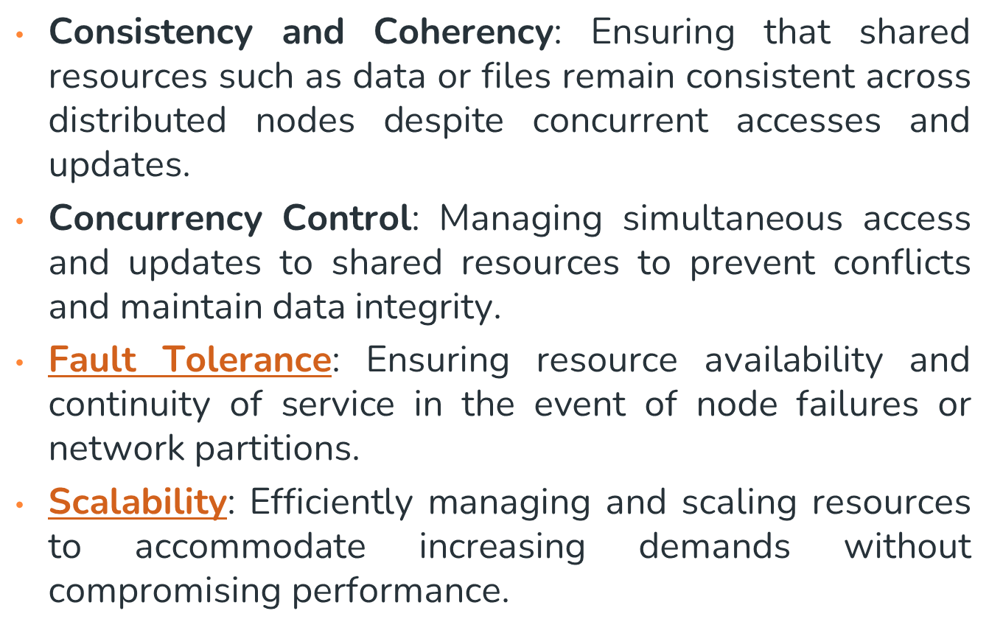

Slide 52
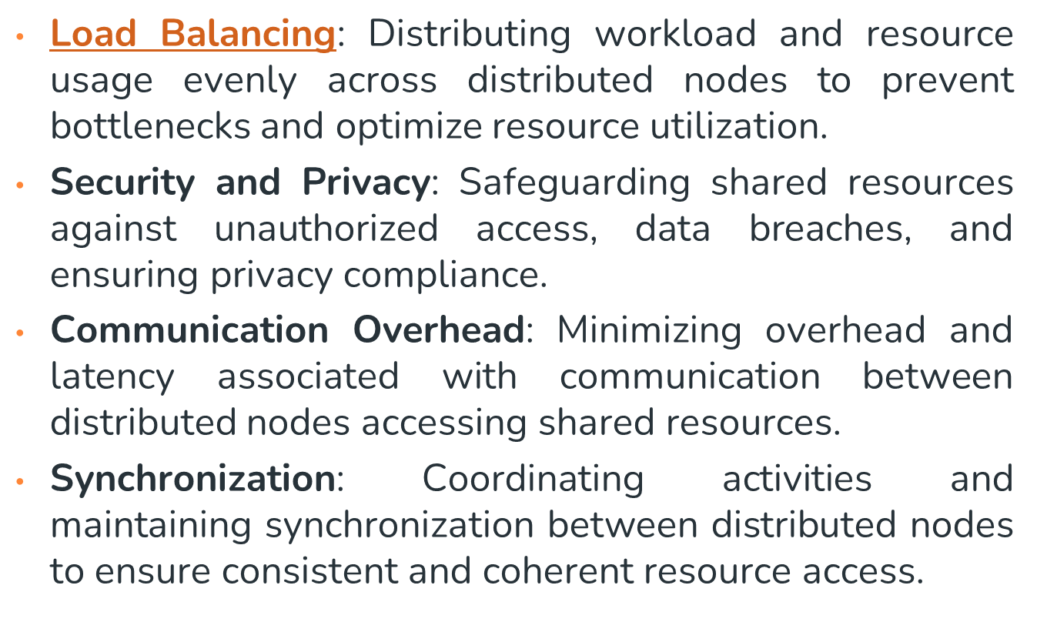

Slide 53
Systems models
Architectural Models (describing components ,and their relationship)
Client server models
Peer process models
Fundamental Models
Interaction Model
Failure Model
Security Model
(formal description of properties common in all architectural models)

Slide 54
ARCHITECTURAL ELEMENTS
• What are the entities
• How do they communicate, or, more specifically, what communication paradigm is used?
• What (potentially changing) roles and responsibilities do they have in the overall architecture?
• How are they mapped on to the physical distributed infrastructure (what is their placement)?

Slide 55
COMMUNICATING ENTITIES
From a system perspective, entities are typically processes.
  In some primitive environments, such as sensor networks, the entities are nodes.
  In most distributed system environments, processes are supplemented by threads, that are the endpoints of communication

Slide 56
Objects: Objects have been introduced to enable and encourage the use of object oriented approaches in distributed systems
Components:
Web services:
Communication paradigms
  Inter-process communication - low-level support for communication between processes in distributed systems by message passing.
  Remote invocation - the most common communication paradigm in distributed systems.

Slide 57
  Request-reply protocols - Messages from client to server and then from server back to client, containing encoding operation and holding associated arguments.
  Remote procedure calls - The underlying RPC system then hides important aspects of distribution, including the encoding and decoding of parameters
  Remote method invocation

Slide 58
Architectural models
Simplification by distinction between client, server and peer processes
  Assessment of workload (responsibilities)
  Failure impact analysis
More dynamic systems can be built as variations on the client-server model
  Moving code (from one process to another process)
    Ex:: Client can download code from server & run it locally.
    Code & objects are moved to reduce access delays & minimize comm. Traffic.
  Adding/removing nodes or components
    Discovery and advertisement of services
    (Some DS enable comp & other mobile devices to be added or removed seamlessly, & allowed them to discover the available services & to offer their services to others.)

Slide 59
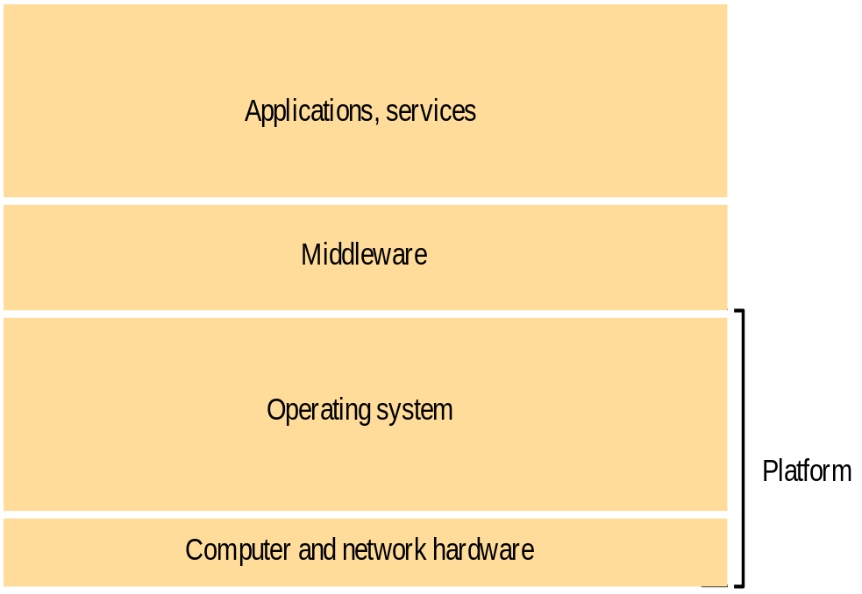
Service Layers
Software architecture
  Structuring software as layers or modules
  Services offered and requested by processes on same or different computers (More recently)
Service layers::
A distributed service can be provided by one or more interacting server processes
  Ex:: Network Time Protocol
Software and Hardware service layers in DS

Slide 60
Service Layers
Middleware::
  Masks heterogeneity & provide convenient prog. Model to application programmers.
  Represented by processes or objects in a set of computers that interact with each other to implement communication & resource sharing,
  To Implement communication and resource sharing
    RMI
    Group communication
  Supplies application programming interface
  Provides
    Building blocks for software components

Slide 61
Service Layers: Middleware
Object oriented Middleware products & standards are::
  Examples:
    Sun RPC
      Simple, remote procedure calling package
    CORBA(Common Object Request Broker Architecture)
      CORBA is useful because it enables separate pieces of software written in different languages and running on different computers to work with each other like a single application or set of services.
      SERVICES:--Namming,Security,event notification,persistant storage, transactions.
    Microsoft DCOM(Distributed Component Object Model)
      is a proprietary Microsoft technology for communication among software components distributed across networked computers.
    Java RMI

Slide 62
Service Layers: Middleware
Middleware services
  Naming
  Security
  Transactions
  Persistent storage
  Event notification
Limitations
  Many distributed applications rely entirely on the services provided by the available middleware to support their needs for communication & data sharing
    TCP reliable for packets (basic error correction and detection)
    Mail transfer service increase fault tolerance (maintain record of progress)
    Some functions can only be correctly implemented with the help of application level information
      Correct behaviour in distributed programs depends upon checks, error-correction mechanisms & security mechanism at various levels

Slide 63
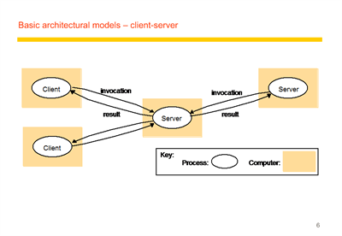

Slide 64
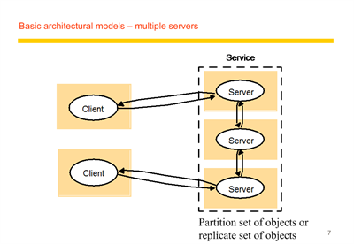

Slide 65
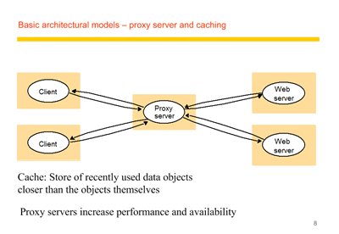

Slide 66
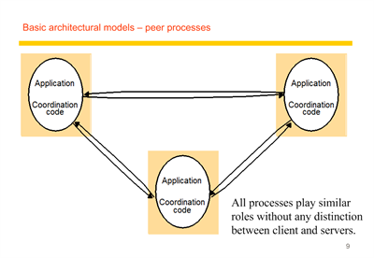

Slide 67
Variations on client server model
Use of mobile code and mobile agents
To be able to add and remove mobile devices in a convenient manner.

Slide 68
Mobile code & Mobile agents
Mobile code
eg applets
Only the code can be accessed
Mobile agents
It’s a running program that includes
Both code + data

Slide 69

Web applets
Client
Web
Applet code
server
b) client interacts with the applet
Web
Client
Applet
server

Slide 70
Mobile Devices and Spontaneous networking
Music
service
Alarm
gateway
service
Internet
Hotel wireless
Discovery
network
service
Camera
TV/PC
Laptop
Guests
PDA
devices

Slide 71
Mobile Devices and Spontaneous networking
Key features
  Easy connection to local network
    Transparently reconfigured devices
  Easy integration with local services
    Autonomous service discoveries
Issues
  Internet addressing, and routing assumption
    computers are at fixed locations
  Limited connectivity
  Security and privacy
Discovery services
  Registration service
  Lookup service

Slide 72
FUNDAMENTAL MODELS
Interaction model
Failure model
Security model

Slide 73
4.1 NAMING
A name is resolved when translated into an interpretable form for resource/object reference.
  Communication identifier (IP address + port number)
  Name resolution involves several translation steps
Design considerations
  Choice of name space for each resource type
  Name service to resolve resource names to comm. id.
Name services include naming context resolution, hierarchical structure, resource protection
Notes:
Name: names that can be interpreted by users or by programs
Identifier: names that can be interpreted or used only by programs. At each name translation step, a name or identifier is mapped to a lower-level identifier that can be used to specify a resource when communicating with some software component, until a communication id is produced that is acceptable to the communication subsystem, and that is used to transmit a request to a resource manager.
Names having some hierarchical structure
representing an internal hierarchic name space (/etc/passwd)
organizational hierarchy (cse.cuhk.edu.hk)
a flat set of numeric or symbolic identifier
advantages: each part of a name is resolved relative to a separate context, and the same name may be used with different meaning in different context
Names are always resolved relative to some context. Contexts are represented by name tables or databases. In the case of file systems, each directory represents a context. To resolve a name, we must supply the context and the name. A name service accepts requests for the translation of names or identifiers in one name space to identifier in some other space. It also handles name registration, deletion, and provides up-to-date information.
Naming schemes can be designed to protect the resources from unauthorized access. Each id is chosen so that it is hard to reproduce, and their client’s authority is being checked by the naming service. Ids which meet this requirement are known as capabilities.

Slide 74
4.2 COMMUNICATION
Separated components communicate with sending processes and receiving processes for data transfer and synchronization.
Message passing: send and receive primitives
  synchronous or blocking
  asynchronous or non-blocking
  Abstractions defined: channels, sockets, ports.
Communication patterns: client-server communication (e.g., RPC, function shipping) and group multicast
Notes:
Synchronization prevent sending or receiving process from continuing until the other process makes an action that frees it.
Each message-passing action involves the transmission by the sending process of a set of data values (a message) through a specified communication mechanism (a channel or port) and the acceptance by the receiving process of a message.
Synchronous (blocking) means that the sender waits after transmitting a message until the receiver has performed a receive operation.
Asynchronous (non-blocking) means that the message is placed in a queue of messages waiting for the receiver to accept them and the sending process can proceed immediately.
Distributed systems can be designed entirely in terms of message-passing, but there are certain useful communication patterns (collective of primitives for high-level operations).
Client-server communication model is for service provision: 1. Transmission of a request from a client to a server; 2. Execution of the request by the server; 3. Transmission of a reply to the client.
Function shipping: the server acts as an execution environment and interpreter for programs, and clients transmit sequences of instructions for interpretation (e.g., PostScript files sent to printer).
Multicasting: sending a message to the members of a specified group of processes. Multicasting examples: locating an object, fault tolerance, and multiple update.

Slide 75
4.3 SOFTWARE STRUCTURE
Layers in centralized computer systems:
Applications
Middleware
Operating system
Computer and Network Hardware
Notes:
Middleware provides run-time support for programming language, such as interpreters and libraries
OS is the main system software to manage basic resources and to provide user and application services:
Basic resource management:
- memory allocation and protection
- process creation and processor scheduling
- peripheral device handling
User and application services:
- user authentication and access control (e.g., login facilities)
- file management and file access facilities
- clock facilities

Slide 76
4.3 SOFTWARE STRUCTURE
Layers and dependencies in distributed systems:
Applications
Open
services
Distributed programming
support
Open system kernel services
Computer and network hardware
Notes:
Kernel only perform basic resource management with the addition of inter-process communication
A new class of software component called open services to provide all other shared resources and services.
Kernels are not designed to be modified routinely. Any services that do not require privileged access to the kernels’ code and data or the hardware of the computer need not be included in the kernel.
A shared horizontal line signified that services provided by the box below the line are directly used by the components above it. E.g., application program may use OS kernel services, distributed programming support and open services.
Micro-kernels: the kernels that provide the smallest possible set of services and resources on which the remaining services required can be built. Typically this basic set of services includes a process abstraction and a basic communication service.
Open services: The distinction between kernel services and open services is made because kernel cannot be open, as they must enforce their own protection against run-time modification. Openness means that distributed systems can be configured to the particular needs of a given community of users or set of applications.
Distributed programming support includes run-time support for language facilities that allow programs written in conventional languages to work together.

Slide 77
4.4 SYSTEM ARCHITECTURES
Client-Server
Peer-to-Peer
Services provided by multiple servers
Proxy servers and caches
Mobile code and mobile agents
Network computers
Thin clients and mobile devices

Slide 78
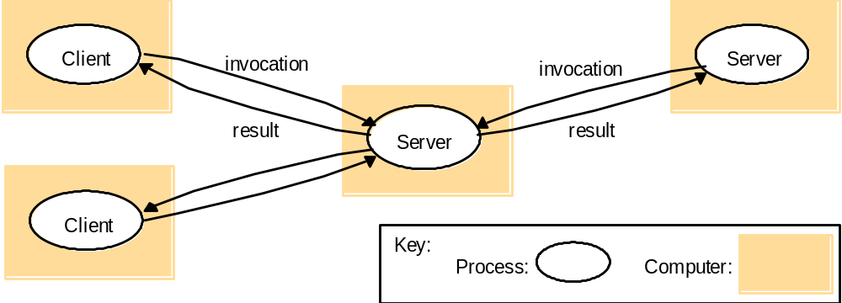
4.4.1 CLIENTS INVOKE INDIVIDUAL SERVERS

Slide 79
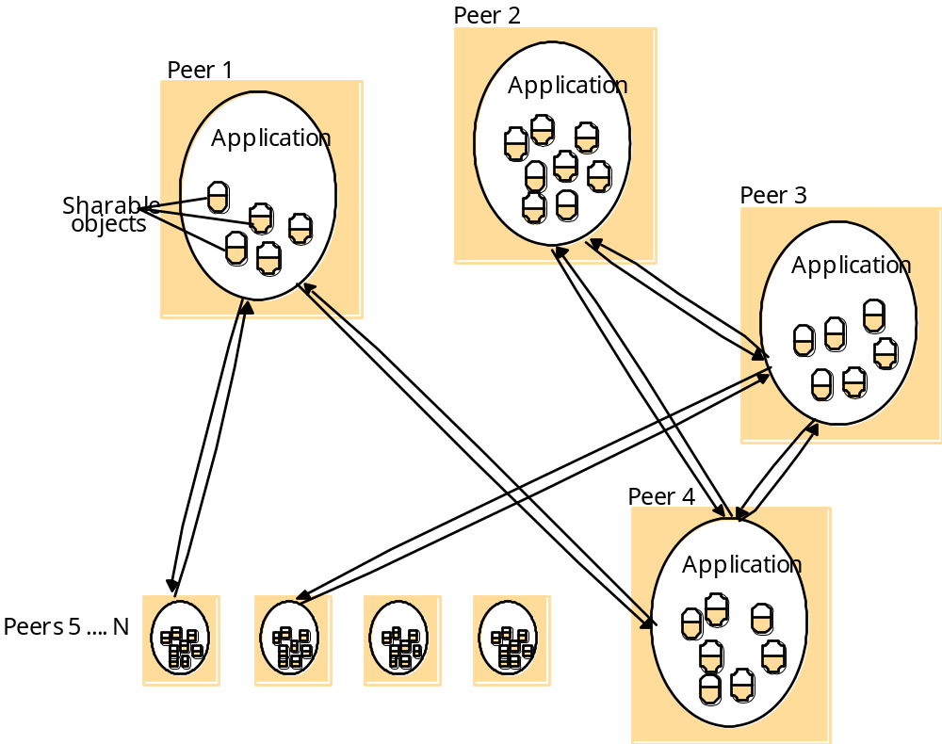
4.4.2 PEER-TO-PEER SYSTEMS

Slide 80
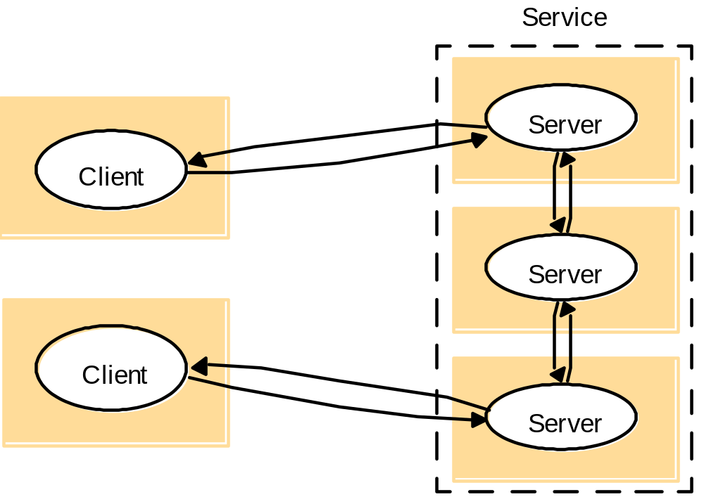
4.4.3 A SERVICE BY MULTIPLE SERVERS
Notes:
Load sharing
Redundancy

Slide 81
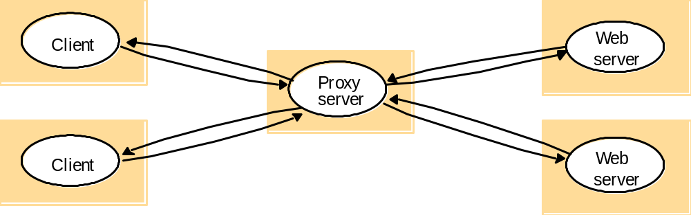
4.4.4 WEB PROXY SERVER

Slide 82
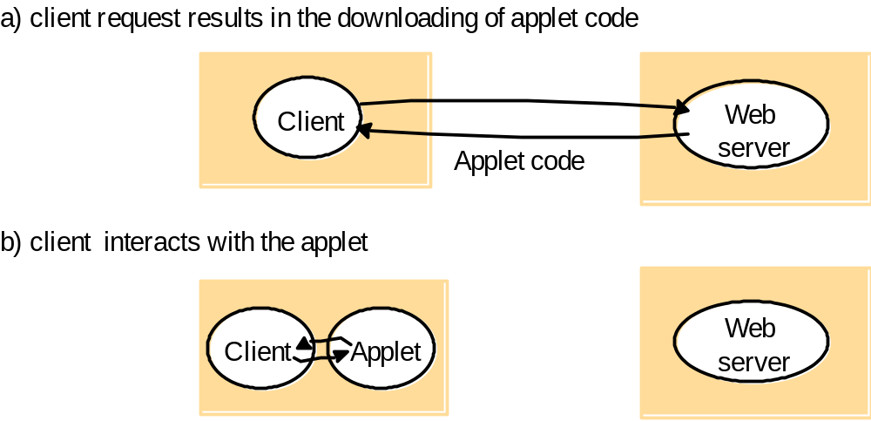
4.4.5 WEB APPLETS

Slide 83
4.4.6 THIN CLIENTS AND COMPUTE SERVERS
Compute server
Network computer or PC
Thin
network
Application
Client
Process

Slide 84
FUNDAMENTAL MODELS
Interaction model
Computation occurs within processes; the processes interact by passing messages, resulting in communication (information flow) and coordination (synchronization and ordering of activities) between processes. In the analysis and design of distributed systems we are concerned especially with these interactions.
The interaction model must reflect the facts that communication takes place with delays that are often of considerable duration, and that the accuracy with which independent processes can be coordinated is limited by these delays and by the difficulty of maintaining the same notion of time across all the computers in a distributed system
Failure model
Our model defines and classifies the faults. This provides a basis for the analysis of their potential effects and for the design of systems that are able to tolerate faults of each type while continuing to run correctly.

Slide 85
Security model
The modular nature of distributed systems and their openness exposes them to attack by both external and internal agents.
Our security model defines and classifies the forms that such attacks may take, providing a basis for the analysis of threats to a system and for the design of systems that are able to resist them.

Slide 86
INTERACTION MODEL
Performance of communication channels
Computer clocks and timing events
Two variants of the interaction model
Event ordering

Slide 87
PERFORMANCE OF COMMUNICATION CHANNELS
Communication over a computer network has the following performance characteristics relating to latency, bandwidth and jitter:
The delay between the start of a message’s transmission from one process and the beginning of its receipt by another is referred to as latency.
  The delay in accessing the network, which increases significantly when the network is heavily loaded. For example, for Ethernet transmission the sending station waits for the network to be free of traffic.
  The time taken by the operating system communication services at both the sending and the receiving processes, which varies according to the current load on the operating systems.
The bandwidth of a computer network is the total amount of information that can be transmitted over it in a given time. When a large number of communication channels are using the same network, they have to share the available bandwidth.

Slide 88
Jitter is the variation in the time taken to deliver a series of messages. Jitter is relevant to multimedia data. For example, if consecutive samples of audio data are played with differing time intervals, the sound will be badly distorted.
Computer clocks and timing events
Each computer in a distributed system has its own internal clock, which can be used by local processes to obtain the value of the current time. Therefore two processes running on different computers can each associate timestamps with their events. However, even if the two processes read their clocks at the same time, their local clocks may supply different time values.
There are several approaches to correcting the times on computer clocks.
The resulting agreement between the times on the local clocks is, of course, affected by variable message delays.

Slide 89
Two variants of the interaction model
In a distributed system it is hard to set limits on the time that can be taken for process execution, message delivery or clock drift.
Two opposing extreme positions provide a pair of simple models – the first has a strong assumption of time and the second makes no assumptions about time:
Synchronous distributed systems: Hadzilacos and Toueg [1994] define synchronous distributed system to be one in which the following bounds are defined:
• The time to execute each step of a process has known lower and upper bounds.
• Each message transmitted over a channel is received within a known bounded time.
• Each process has a local clock whose drift rate from real time has a known bound.

Slide 90
Asynchronous distributed systems: Many distributed systems, such as the Internet, are very useful without being able to qualify as synchronous systems. Therefore we need an alternative model. An asynchronous distributed system is one in which there are no bounds on:
Process execution speeds – for example, one process step may take only a picosecond and another a century; all that can be said is that each step may take an arbitrarily long time.
Message transmission delays – for example, one message from process A to process B may be delivered in negligible time and another may take several years. In other words, a message may be received after an arbitrarily long time.
Clock drift rates – again, the drift rate of a clock is arbitrary.

Slide 91
TWO VARIANTS OF THE INTERACTION MODEL
Synchronous distributed system
  The time to execute each step f a process has known lower and uper bounds.
  Each message transmitted over a channel is received within a known bounded time
  Each process has a local clock whose drift rate from real time has a known bound.
Asynchronous distributed system
  No bound on process executiong speeds
  No bound on message transmisson delays
  No bound on clock drift rates.

Slide 92
EVENT ORDERING
In many cases, we are interested in knowing whether an event (sending or receiving a message) at one process occurred before, after or concurrently with another event at another process. The execution of a system can be described in terms of events and their ordering despite the lack of accurate clocks.
For example, consider the following set of exchanges between a group of email users, X, Y, Z and A, on a mailing list:
1. User X sends a message with the subject Meeting.
2. Users Y and Z reply by sending a message with the subject Re: Meeting.

Slide 93
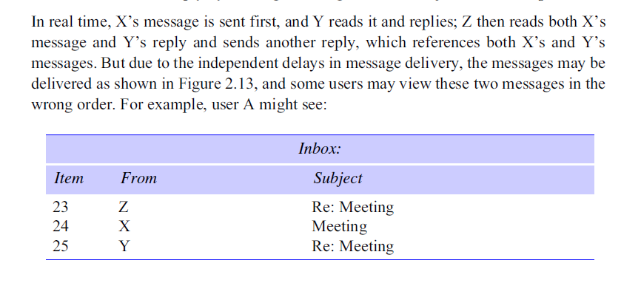
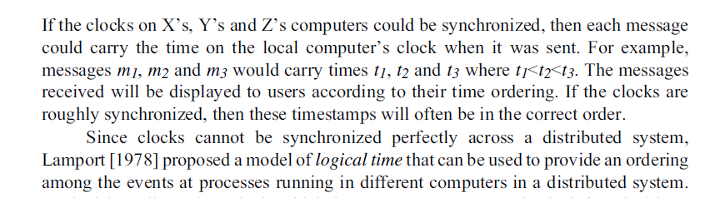

Slide 94
FAILURE MODEL
Omission failures
Arbitrary failures
Failure detection
Impossibility of reaching agreement in the presence of failure
Masking failure
Reliability of one to one communication

Slide 95
Omission failures
The faults classified as omission failures refer to cases when a process or communication channel fails .
Process omission failures: The chief omission failure of a process is to crash. When we say that a process has crashed we mean that it has halted and will not execute any further steps of its program ever.
A process crash is called fail-stop if other processes can detect certainly that the process has crashed. Fail-stop behavior can be produced in a synchronous system if the processes use timeouts to detect when other processes fail to respond and messages are guaranteed to be delivered.
For example, if processes p and q are programmed for q to reply to a message from p, and if process p has received no reply from process q in a maximum time measured on p’s local clock, then process p may conclude that process q has failed.

Slide 96
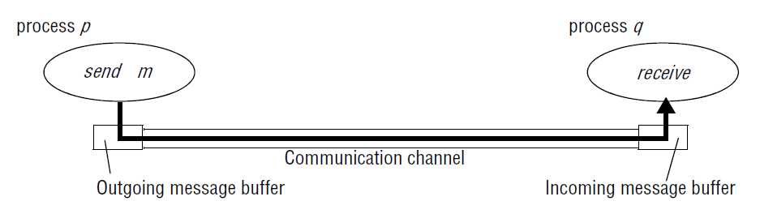
Communication omission failures:
Consider the communication primitives send and receive. A process p performs a send by inserting the message m in its outgoing message buffer. The communication channel transports m to q’s incoming message buffer.
Process q performs a receive by taking m from its incoming message buffer and delivering it
The communication channel produces an omission failure if it does not transport a message from p’s outgoing message buffer to q’s incoming message buffer. This is known as ‘dropping messages’ and is generally caused by lack of buffer space

Slide 97
Hadzilacos and Toueg [1994] refer to the loss of messages between the sending process and the outgoing message buffer as sendomission failures, to loss of messages between the incoming message buffer and the receiving process as receive-omission failures, and to loss of messages in between as channel omission failures.

Slide 98
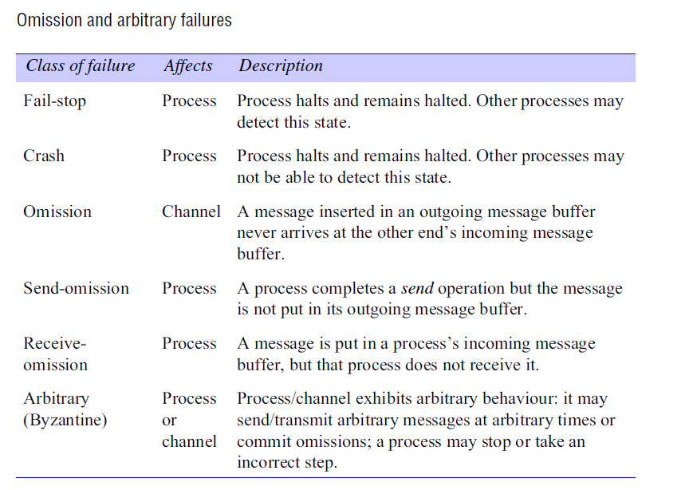

Slide 99
Arbitrary failures
The term arbitrary or Byzantine failure is used to describe the worst possible failure semantics, in which any type of error may occur.
  A process may set wrong values in its data items, or it may return a wrong value in response to an invocation.
Timing failures •
  Timing failures are applicable in synchronous distributed systems where time limits are set on process execution time, message delivery time and clock drift rate.
Masking failure
  Each component in a distributed system is generally constructed from a collection of other components. It is possible to construct reliable services from components that exhibit failures. For example, multiple servers that hold replicas of data can continue to provide a service when one of them crashes

Slide 100
Reliability of one to one communication
  Validity: Any message in the outgoing message buffer is eventually delivered to the incoming message buffer.
  Integrity: The message received is identical to one sent, and no messages are delivered twice.

Slide 101
SECURITY MODEL
Protecting objects
Securing processes and their interactions
The enemy
Defeating security threats
Other possible threats from the enemy

Slide 102
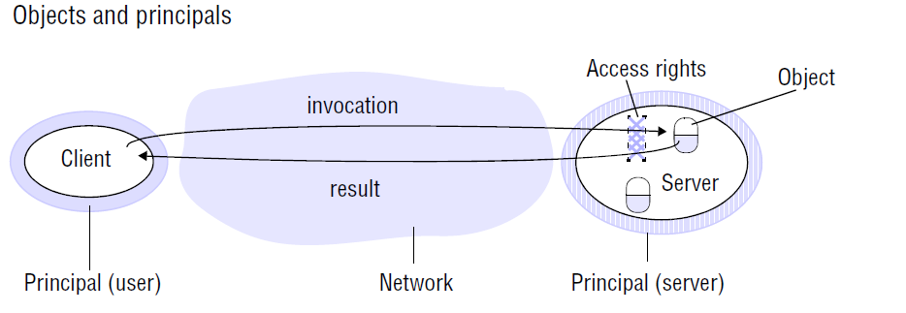
Objects are intended to be used in different ways by different users. For example, some objects may hold a user’s private data, such as their mailbox, and other objects may hold shared data such as web pages. To support this, access rights specify who is allowed to perform the operations of an object – for example, who is allowed to read or to write its state.

Slide 103

Securing processes and their interactions
The server is responsible for verifying the identity of the principal behind each invocation and checking that they have sufficient access rights to perform the requested operation on the particular object invoked, rejecting those that do not.
The client may check the identity of the principal behind the server to ensure that the result comes from the required server.

Slide 104
Defeating security threats
Cryptography and shared secrets
Authentication:
Secure channels:
A secure channel ensures the privacy and integrity (protection against tampering) of the data transmitted across it.
• Each message includes a physical or logical timestamp to prevent messages from being replayed or reordered.

Slide 105
Other possible threats from an enemy
Denial of service:
Mobile code

Slide 106
EXERCISE
The host computers used in peer-to-peer systems are often simply desktop computers in users’ offices or homes. What are the implications of this for the availability and security of any shared data objects that they hold and to what extent can any weaknesses be overcome through the use of replication? pages 47, 48
List the types of local resource that are vulnerable to an attack by an untrusted program that is downloaded from a remote site and run in a local computer page 50

Slide 107
5. SUMMARY
Definitions of distributed systems and comparisons to centralized systems.
The characteristics of distributed systems.
The eight forms of transparency.
The basic design issues.
Read Chapter 1 and Chapter 2 of the textbook.
(DISTRIBUTED SYSTEMS Concepts and Design Fifth Edition George Coulouris)
Notes:
Read textbook Chapter 1 and Chapter 2.

